Slide 1
Computer Programming in Python
Chapter 9
Classes and Objects

Slide 2
Chapter 9 Classes and Objects
Two Approaches to Programming
Procedural
Order of operations follows a flow of control where a specific task is completed, and then another, and then another, and so on
The functions are called (some are passed data) to complete a specific task
The data and the functionality are separate

Slide 3
Chapter 9 Classes and Objects
Two Approaches to Programming
Object-oriented programming (OOP)
Data and functionality are combined in an object and are hidden from the rest of the program
This is referred to as encapsulation
Data items stored by an object are referred to as attributes or members (sometimes member variables)
Functionality within an object is referred to as methods or behaviors

Slide 4
Chapter 9 Classes and Objects
Object-oriented Programming (OOP)
Terminology
Varies depending on the programming language
Objects have data elements (attributes)
Variables (also referred to as members)
Objects have methods (behaviors)
Operate on the data elements
Provide an interface for other objects and other parts of the program to access and operate on them

Slide 5
Chapter 9 Classes and Objects
Object-oriented Programming
The data is hidden from outside the object to protect it from being corrupted or changed arbitrarily
Parts of a program and other objects can access the object’s attributes through a public interface which provides protection for the data
Referred to as information hiding
Programs can use an object without knowing the inner workings

Slide 6
Chapter 9 Classes and Objects
Public Interface
Interacting with an object through the public interface only requires knowledge of the interface
Future changes to an object internally do not necessarily require changes to a program that uses that object
Unless the public interface has changed, there is typically no need to modify programs that use the object

Slide 7
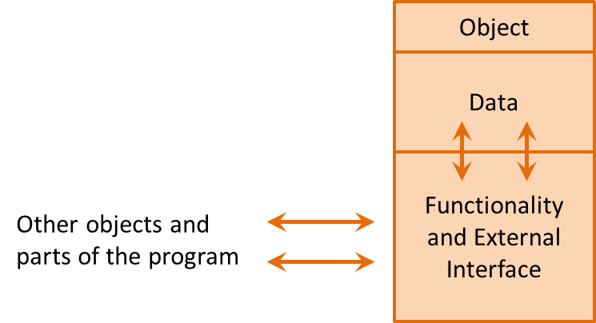
Chapter 9 Classes and Objects
Public Interface
Interacting with an object through the public interface only requires knowledge of the interface

Slide 8
Chapter 9 Classes and Objects
Classes
A class is a framework or blueprint of what the object will contain when it is created
An architect can provide a detailed drawing of a building that shows a door, but the door cannot be opened
A building must be built from the drawing, and then the door of the building can be opened
The building would be an instance of the drawing the same way that an object is an instance of a class

Slide 9
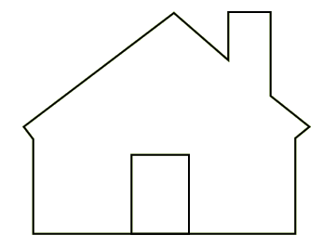
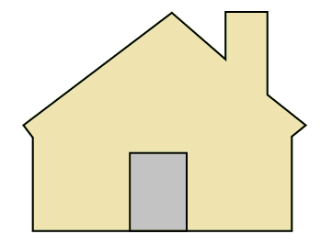
Chapter 9 Classes and Objects
Classes
Multiple buildings could be built from the same drawing, they would be identical, and they would each have their own door
Multiple objects can be instantiated from a single class, and they would each have their own set of attributes
Class
Object 1
Object 2
Instance
Instance

Slide 10
Chapter 9 Classes and Objects
Classes
The class definition defines the attributes for a class
Outlines the data attributes and methods for the class

Slide 11
Chapter 9 Classes and Objects
Class Definition
Begins with the class key word and the name of the class
The naming convention for classes is to begin each word with an uppercase letter

Slide 12
Chapter 9 Classes and Objects
Class Definition
The next line defines the constructor which looks like a function or method header
Includes the word __init__ (short for initializer)
It is preceded and followed by two underscores

Slide 13
Chapter 9 Classes and Objects
Class Definition
The constructor executes when an object of the class is created
Any parameters used by the constructor would be included along with the parameter self which is a reference to the object being created
self is typical and considered the standard although root and others are common

Slide 14
Chapter 9 Classes and Objects
Class Definition Example
A Reservation Class
Attributes for name, day, time, number of guests
To create an instance of the Reservation class requires passing the constructor a name, day, time, and number of guests

Slide 15
Chapter 9 Classes and Objects
Class Definition Example
The four lines within the class declare and initialize the instance attributes using the values of the parameters that were passed to the constructor

Slide 16
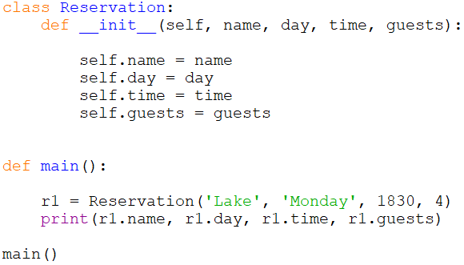
Chapter 9 Classes and Objects
Class Definition Example
r1 is an instance of the Reservation class

Slide 17
Chapter 9 Classes and Objects
Class Definition Example
Each Reservation object created will have its own set of attributes with its own set of values
If there were methods, each object would have its own set of methods
The values stored in the instance attributes are referred to as the object’s state
Reservation r1
name Lake
day Monday
time 1830
guests 4
state of r1

Slide 18
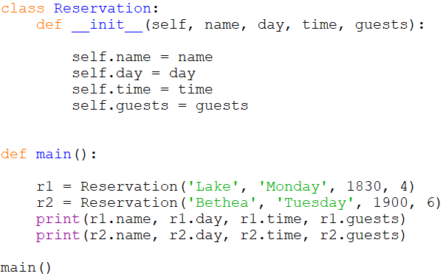
Chapter 9 Classes and Objects
Two objects (r1 and r2) with different attribute values (states)

Slide 19
Chapter 9 Classes and Objects
Classes
Some class constructors receive no parameters when an object is created
There would usually be methods within the class for assigning values to the attributes
Also, consider that a Reservation may need to be changed
To provide for this capability, a method would be added to the class definition which would allow a change to the state of the object
Through the public interface

Slide 20
Chapter 9 Classes and Objects
Class Methods
The behavior of an object is specified by writing methods in the class definition
A method is like a function, but it is inside an object and interacts with the data elements of the object
These methods provide the public interface
Class Methods provide a public interface

Slide 21
Chapter 9 Classes and Objects
Class Methods
The Reservation class could provide the functionality to change the time of the reservation
A program using the class could then change the state of time through this method
Class Method to change the time attribute

Slide 22
Chapter 9 Classes and Objects
Class Methods
The method would be included in the class definition
The first parameter is the object on which the method is being called
It is received as self by the method
The second is the time that will be assigned to the time attribute of the object

Slide 23
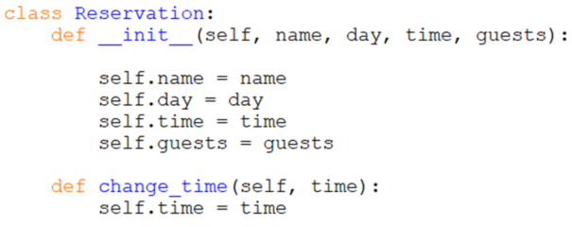
Chapter 9 Classes and Objects
Class Methods
The method is included in the class
Note the indentation and alignment

Slide 24
Chapter 9 Classes and Objects
Class Methods
After an object of the class is created, the method can be called
Object name, the dot operator, and the method name
Only one argument is passed to the method
The object reference is passed automatically
r1.change_time(1800)
The object reference is passed automatically

Slide 25
Chapter 9 Classes and Objects
Class Methods
Methods to enable changing each of the Reservation attributes could be added
If the constructor for a class does not have parameters, all of the attributes for the class might be set through methods
Different requirements call for different solutions

Slide 26
Chapter 9 Classes and Objects
Class Methods
So how does this protect the data attribute?
The public interface methods can include protections like input validation

Slide 27
Chapter 9 Classes and Objects
Class Access Specifiers
Different parts of an object are designated for access using what are referred to as access specifiers
Public Access Modifier: The members declared as public (which is the default) are deemed accessible from outside an object of the class.
Protected Access Modifier: The members designated as protected are deemed accessible only from a class derived from it (a subclass).
Private Access Modifier: These members are designated as only accessible from within the class. Access from outside the class is deemed inappropriate.

Slide 28
Chapter 9 Classes and Objects
Class Access Specifiers
Python does not have an effective way of specifying or enforcing public, protected, and private access, but a convention is used to signify access
A single preceding underscore to indicate protected
Two underscores preceding an item to indicate that it is private
Since Python uses name mangling (beyond the scope of this text), some protection is afforded private elements (although they are still technically accessible)

Slide 29
Chapter 9 Classes and Objects
Class Access Specifiers
The Reservation class with the attributes specified as private attributes
Specify attributes as private using two underscores

Slide 30
Chapter 9 Classes and Objects
Class Methods - Mutators
Methods that change the state (attributes) of an object are referred to as mutator methods
Should have names that indicate what they change and typically begin with the word set
Often referred to as ‘setters’
# mutator method
Mutator Methods change object attributes

Slide 31
Chapter 9 Classes and Objects
Class Methods - Accessors
Methods that access an object’s attributes without changing them are referred to as accessor methods
Should have names that indicate what they access and typically begin with the word get
Often referred to as getters
# accessor method
Accessor Methods access object attributes

Slide 32
Chapter 9 Classes and Objects
Public Interface
With the attributes of an object defined as private, the public interface provides the only access to them
There is no other way for another part of the program or another object to access or change the data

Slide 33
Chapter 9 Classes and Objects
Class Attributes
An attribute that is declared outside the __init__ function is a Class attribute and is shared by all objects of the class
Useful for class constants, tracking data across all instances of the class (similar to static variables), and for defining defaults values
A class attribute can be accessed using the class name or the objects name
Class attributes are shared by all objects of the class

Slide 34
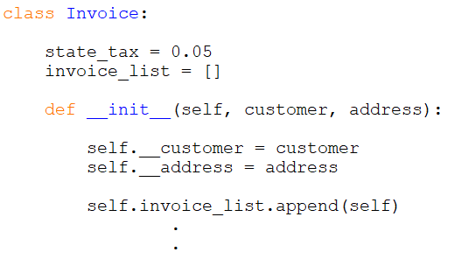
Chapter 9 Classes and Objects
Business Program Invoice Class
Class attributes for a state tax and list of invoices
Shared by all instances (objects) of the class
When an invoice object is created, the constructor adds it the list
Class Attributes
Defined outside
any function

Slide 35
Chapter 9 Classes and Objects
Class Files and Modularization
Class definitions are typically located in separate files
Aligns with the process of modularization, or separating a program into distinct parts
Provides many benefits including the ability to:
Reuse portions of the code
Divide the program development among multiple programmers
Simplify the overall project

Slide 36
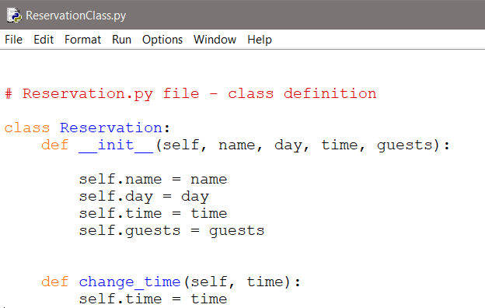
Chapter 9 Classes and Objects
Class Files and Modularization
Reservation Class File

Slide 37
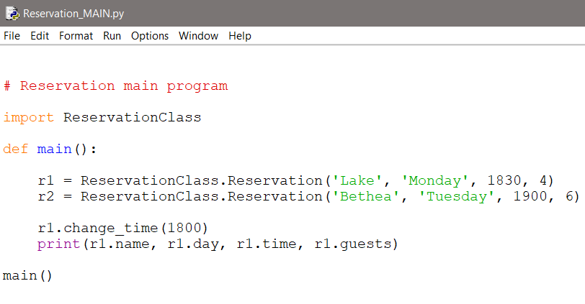
Chapter 9 Classes and Objects
Class Files and Modularization
Reservation Class File imported into the main file
File name must be added

Slide 38
Chapter 9 Classes and Objects
Displaying the State of an Object
The print function will not display an object’s state
It will display an objects location in memory
Python provides the capability to write a method that returns a programmer defined string of what is to be displayed
The __str__ method will be used by the object when the print function is called

Slide 39
Chapter 9 Classes and Objects
Displaying the State of an Object
When the print function is called with an object, the programmer defined __str__ method is executed
The method is defined within the class

Slide 40
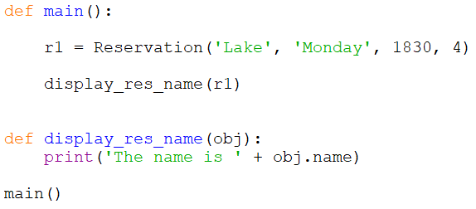
Chapter 9 Classes and Objects
Objects as Arguments
When passing objects as arguments to functions and methods, the parameter is a reference to the object
Provides access to the object’s methods and attributes by using the name of the object

Slide 41
Chapter 9 Classes and Objects
Designing Classes

Slide 42
Chapter 9 Classes and Objects
Designing Classes
Determine the data attributes
Determine the public interface (methods) needed to access and change the data when appropriate
Most classes model real-world objects and should represent a clear and single abstraction
The class should not include functionality that is outside its responsibilities like getting user input, or anything that is specific to a particular program

Slide 43
Chapter 9 Classes and Objects
Designing Classes
A goal of OOP is reuse, another is cohesion
The degree to which a class represents a single abstraction without external dependencies – high cohesion
The degree to which a class depends on another is referred to as coupling
OOP strives for loose coupling
A class should have cohesion (represent a stand-alone entity), and loose coupling (no external dependencies).

Slide 44
Chapter 9 Classes and Objects
Designing Classes - Tools
Class Responsibility and Collaborator or CRC Cards
Teams brain-storm ideas and note the nouns and verbs used when describing a class
Nouns represent instance variables (data elements)
Verbs represent the methods that will act on the data including the public interface
The goal is to capture all possible data elements and methods, and then refine the lists as the design evolves.

Slide 45
Chapter 9 Classes and Objects
Designing Classes - Tools
Consider the Reservation Class
Nouns Verbs
name get name
day get, change day
time get, change time
guests get, change guests

Slide 46
Chapter 9 Classes and Objects
Designing Classes - Tools
The Unified Modeling Language (UML) was developed as a standard for visualizing and documenting systems and software
UML diagrams are used to design and document classes and object oriented software systems including object interaction

Slide 47
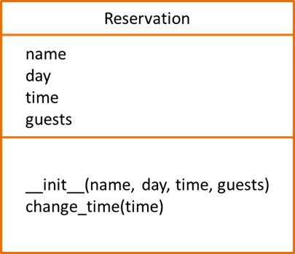
Chapter 9 Classes and Objects
UML Class Diagram
The top section contains the name of the class, the next section describes the data attributes, and the bottom section lists the methods for the class
class name
attributes
class methods

Slide 48
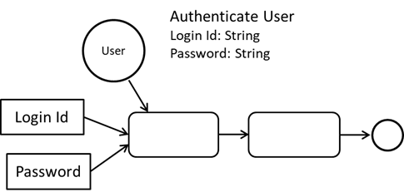
Chapter 9 Classes and Objects
Designing Classes - Tools
UML behavior diagrams (object activity diagrams) are used to show the flow of control, data, and transactions.

Slide 49
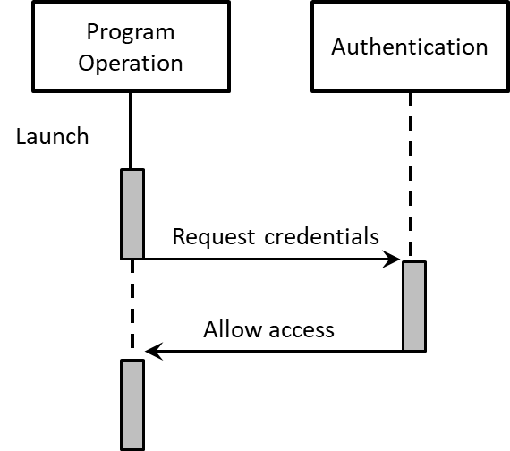
Chapter 9 Classes and Objects
Designing Classes - Tools
The Object Sequence Diagram adds chronology

Slide 50
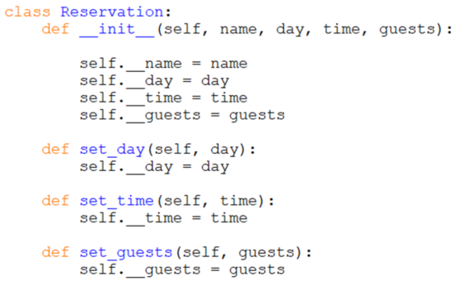
Chapter 9 Classes and Objects
A More Complete Reservation Class

Slide 51
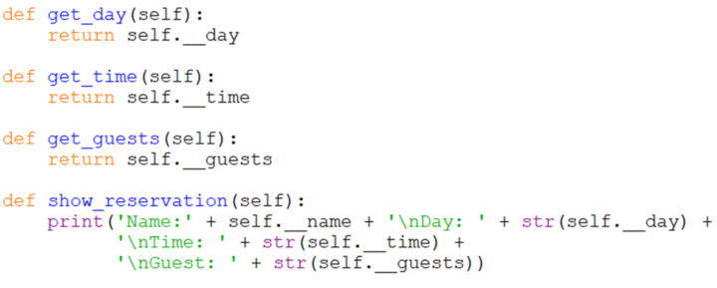
Chapter 9 Classes and Objects
A More Complete Reservation Class

Slide 52
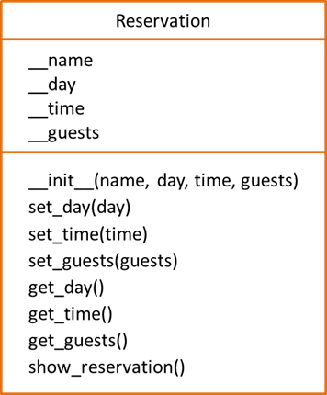
Chapter 9 Classes and Objects
A More Complete Reservation Class UML

Slide 53
Chapter 9 Classes and Objects
Pickling
Objects can be saved in a file either as text or they can be serialized
In Python, serializing objects is called pickling which converts objects into byte streams (0s and 1s)
Import pickle
This allows preserving an object’s state, and for streaming objects across networks from one server to another

Slide 54
Chapter 9 Classes and Objects
Pickling
The pickle module’s dump function serializes an object and writes it to a file
The load function retrieves an object from a file and de-serializes it
Serializing uses two different file modes
‘wb’ to write binary
‘rb’ to read binary
Pickling uses the binary file modes

Slide 55
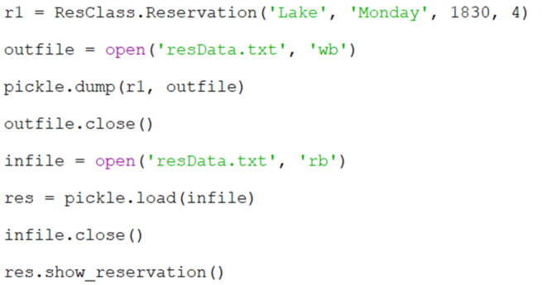
Chapter 9 Classes and Objects
Pickling
serialize
reconstitute

Slide 56
Chapter 9 Classes and Objects
Pickling Warnings
There are many warnings associated with pickling
The pickle module is not secure
Only un-pickle (reconstitute) trusted data
Malicious code can be executed during un-pickling
There are also some data type and function/method limitations
Other products such as JSON provide this capability
JavaScript Object Notation
Only un-pickle (reconstitute) trusted data

Slide 57
Chapter 9 Classes and Objects
Object Inheritance

Slide 58
Chapter 9 Classes and Objects
Inheritance
Objects are often specialized versions of a general class
A restaurant is a business, a clothing store is a business, and so is a theater
They have many things in common like employees, sales, and expenses, but some differences or special characteristics as well

Slide 59
Chapter 9 Classes and Objects
Inheritance
The common characteristics for the businesses could be implemented in a Business class, and then each specific business type could be derived from that class
The derived classes would inherit the common characteristics from the Business class, and would implement those that are specific to them
They would extend the Business Class
This is referred to as the “is a” relationship
This relationship is established through inheritance

Slide 60
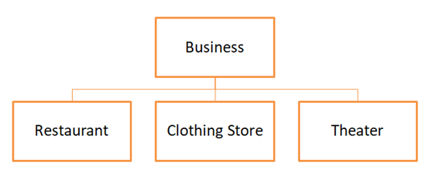
Chapter 9 Classes and Objects
Inheritance
The specialized classes (derived classes or subclasses) inherit the characteristics of the general class (base or super class)
In the diagram, the Business Class is the base class, and the specific businesses are the derived classes

Slide 61
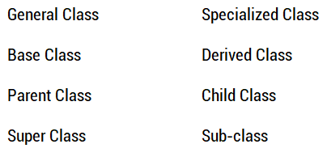
Chapter 9 Classes and Objects
Inheritance – a note about terminology
Different programming languages and texts use different terms to refer to the same thing
Base (General Class) and Derived (Specialized Class)

Slide 62
Chapter 9 Classes and Objects
Inheritance – Example:
A program is needed that can be used by a corporation with different businesses
The common characteristics for all of the businesses would be implemented in the Business Class
Name, and number of employees
The derived classes would contain their specific items and methods

Slide 63
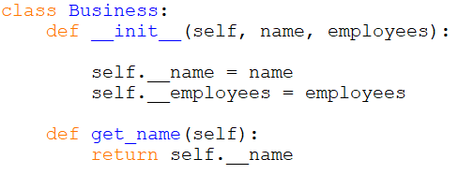
Chapter 9 Classes and Objects
Inheritance – Example:
Business class containing common attributes

Slide 64
Chapter 9 Classes and Objects
Inheritance – Example:
The first line defines a class ClothingStore that inherits from Business
defining the class

Slide 65
Chapter 9 Classes and Objects
Inheritance – Example:
The constructor for Business is called inside the constructor for the ClothingStore
Business constructor

Slide 66
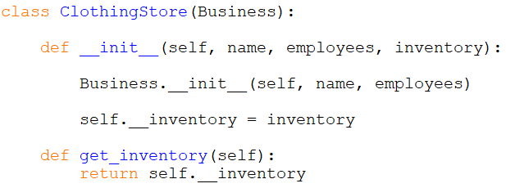
Chapter 9 Classes and Objects
Inheritance – Example:
ClothingStore inherits attributes from the Business class
The ClothingStore has an attribute for inventory

Slide 67
Chapter 9 Classes and Objects
Note the Clothing Store constructor parameters
Clothing Store needs name and employees which are passed to the constructor for the Business class (along with self)
Clothing Store also needs inventory

Slide 68
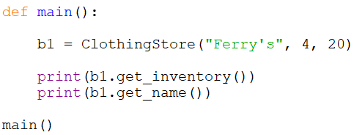
Chapter 9 Classes and Objects
Business Class Methods are Inherited
ClothingStore inherits name, employees, and get_name() from the Business class

Slide 69
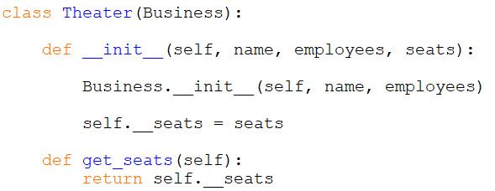
Chapter 9 Classes and Objects
Adding a Theater class as a derived class
In addition to name and employees, the Theater class has an attribute for the number of seats

Slide 70
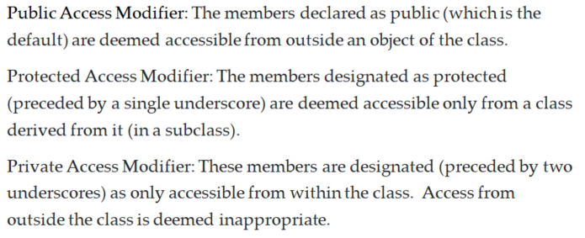
Chapter 9 Classes and Objects
Inheritance is One Way
Base classes do not know anything about derived classes
Derived classes know everything about base classes
Except as noted by Access Qualifiers

Slide 71
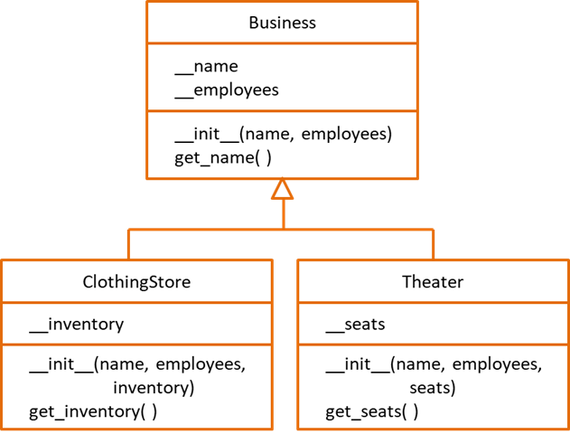
Chapter 9 Classes and Objects
Inheritance in UML
The UML diagram shows that Clothing Store and Theater both inherit from the Business class

Slide 72
Chapter 9 Classes and Objects
Polymorphism
A derived class can have a method with the same name as a method in the base class that operates differently
This is known as polymorphism
The ability to take on many forms
The derived class method can override the base class method

Slide 73
Chapter 9 Classes and Objects
Polymorphism
If the Business Class had a display method, it could include name and employees
They are attributes of the base class
It could not include attributes from the derived classes

Slide 74
Chapter 9 Classes and Objects
Polymorphism
The derived classes could have their own display method that overrides the display method in the base class
The Clothing Store class could have a display method that includes inventory
The Theater class could have a display method that includes number of seats
The proper method would be called based upon the object that is calling the method
Derived class methods can override base class methods

Slide 75
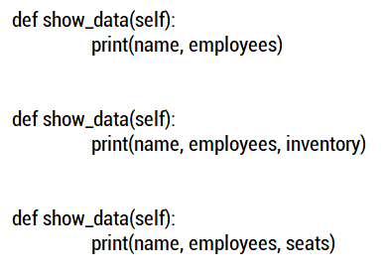
Chapter 9 Classes and Objects
Polymorphism
Each method has the same name and parameter list
Business class method
Clothing Store class method
Theater class method

Slide 76
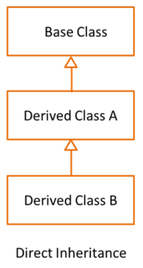
Chapter 9 Classes and Objects
Multiple Class Inheritance
A class can inherit (be derived) from multiple classes
The derived class inherits all of the attributes of both classes
Inline with Access Qualifiers
The hierarchy diagram indicates the direct inheritance of Derived Class B from Derived Class A which inherits from the Base Class

Slide 77
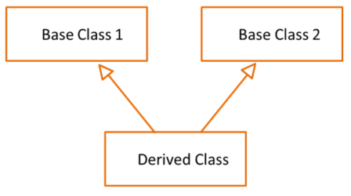
Chapter 9 Classes and Objects
Multiple Class Inheritance
A class can also inherit from two or more distinct classes
Both base classes should be reviewed carefully to avoid conflicts

Slide 78
Chapter 9 Classes and Objects
Multiple Class Inheritance
When defining a class with multiple-inheritance:
Both classes are listed as parameters for the derived class
Both initializers for the other classes are called

Slide 79
Chapter 9 Classes and Objects
Multiple Class Inheritance
Both forms of multiple-inheritance add complexity and make the code and classes harder to re-use in other programs
Both of the inherited classes need to be copied as well
Lowers cohesion and increases coupling
Goal: High cohesion and loose coupling

Slide 80
Chapter 9 Classes and Objects
Determining Class Identity
With complex classes, it is often necessary to determine if an object is an instance of a class
The isinstance function
Returns True if the object is an instance of a class
False if it is not

Slide 81
Chapter 9 Classes and Objects
Chapter 9 Classes and Objects

