Slide 1
Computer Programming in Python
Chapter 7
File Operations and Dialogs

Slide 2
Chapter 7 File Operations
Files
Store information and data used by computers
Data stored in RAM does not persist between runs of the program, or when the computer is turned off
Files allow information to be stored until it is needed, changed when required, and deleted when no longer needed

Slide 3
Chapter 7 File Operations
File Names have a file extension
Three or four letters that follow the period in the file name
spreadsheet.xlsx
File extensions are used by most operating systems to associate the file with an application
When a file is double-clicked, the OS determines the application to launch based upon the file’s extension and the application that was used to open that type of file previously

Slide 4
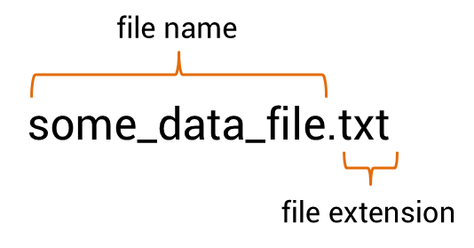
Chapter 7 File Operations
File Extensions
Double-clicking a file named “song.mp3” will launch an audio player because the audio player application has been associated with the mp3 file extension
The “txt” file extension is typical for text files which are usually opened with Notepad or Notes by the computer’s operating system

Slide 5
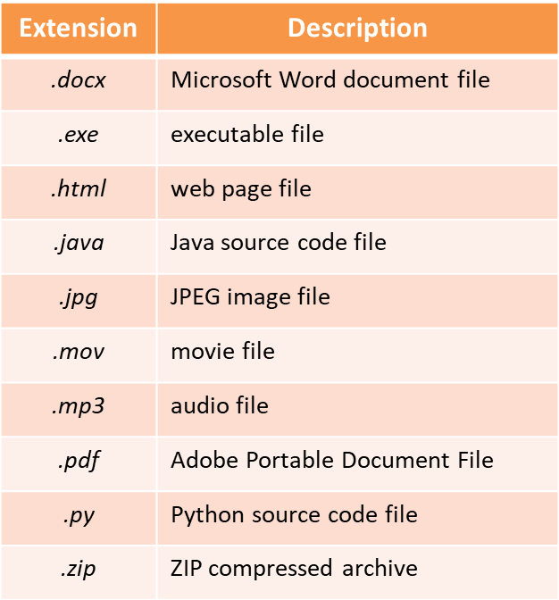
Chapter 7 File Operations
File Extensions
Applications

Slide 6
Chapter 7 File Operations
File Operations
Files being read from by a program are typically referred to as input files
Files being written to as output files
Three (3) steps to using a file in a computer program
The file is opened
The file is processed (either written to or read from)
The file is closed

Slide 7
Chapter 7 File Operations
Opening a File
When a file is opened using Python, it is associated with the program through a file object that has a variable reference
The variable reference is the name to be associated with the file in the program
This is not that different from the way that an integer or float is defined except that the name is associated with a file object
The general format for opening a file is:

Slide 8
Chapter 7 File Operations
Opening a File
The open function is passed two arguments
The first is the actual name of the file
The second is the mode in which the file will be opened
Determines the way that the file will be opened, and what will occur if the file exists or if it does not
reference name
name of file
read mode

Slide 9
Chapter 7 File Operations
Opening a File
When the file name is used as the first argument, the program will search the default directory for the file
Where the program is running
A full path to the file can also be used
Requires ‘r’ before the path to the file
tells Python to disregard
the backslashes in the path
path to file

Slide 10
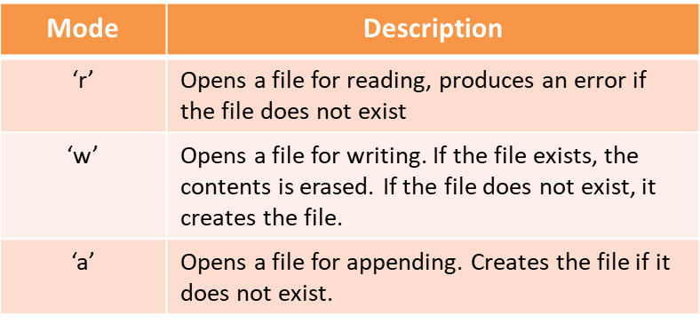
Chapter 7 File Operations
Opening a File
The mode determines the file operation

Slide 11
Chapter 7 File Operations
Opening a File
File objects have methods that simplify some file handling processes
Once a file object is associated with a variable, the variable name is used to access the methods
The only time that the actual file name is used is when the file is being opened
variable reference
open in read mode

Slide 12
Chapter 7 File Operations
Writing to a File
When writing to a file, the write() method is used and is passed what is to be written
The variable reference assigned to the file is followed by the dot operator, and the method name

Slide 13
Chapter 7 File Operations
Closing Files
Using the close() method ensures that no data is lost
Data being written to a file is queued in a buffer (a holding area in memory) for efficiency
Closing the file in the program forces anything being held in the buffer to be written to the file before it is closed
If a program does not close the file, the operating system will eventually close it, but would not check the buffer first

Slide 14
Chapter 7 File Operations
Writing to a File
The write() method will do as it is told, and if the data is to be written on separate lines, then line feeds need to be incorporated into the write statement
This is unlike print which automatically adds a line feed
The escape sequence ‘\n’ is the newline character and is used to produce a line feed in the file

Slide 15
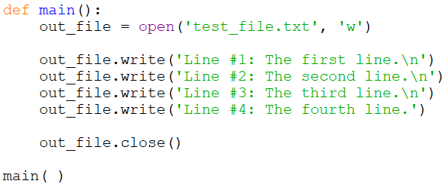
Chapter 7 File Operations
Writing to a File
This example opens a file named “test_file.txt” for writing, associates it with out_file, writes three phrases on separate lines in the file, and closes the file
Line feed

Slide 16
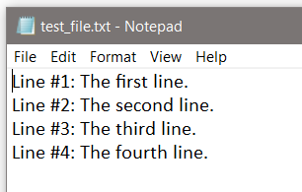
Chapter 7 File Operations
Writing to a File
The example program created the new file, opened it, wrote the lines, and closed the file

Slide 17
Chapter 7 File Operations
Writing to a File
Writing the contents of a variable to a file is handled much like the print function
For a line feed, the newline character is concatenated onto a string variable

Slide 18
Chapter 7 File Operations
Writing to a File
If the value to be written is not a string, the str function must be used to convert it to a string
Numeric values cannot be written to files as numeric values in Python and must be converted to strings
Trying to write a numeric value will cause a TypeError

Slide 19
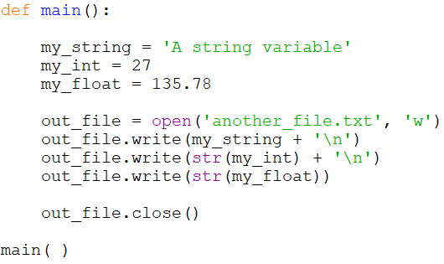
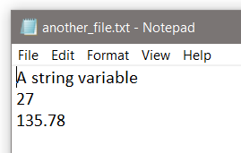
Chapter 7 File Operations
Writing to a File
Converting values to strings example

Slide 20
Chapter 7 File Operations
Writing to a File - Appending
Opening an existing file in write mode erases any data that had been stored in the file
What actually takes place is that the old file is deleted, and a new empty file is created
To append data to existing data, the file is opened in append mode using ‘a’
Any existing data in the file is preserved

Slide 21
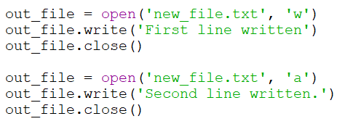
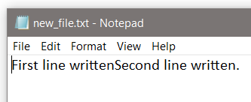
Chapter 7 File Operations
Writing to a File - Appending
Opening an existing file in append mode
append mode
No line feed was added

Slide 22
Chapter 7 File Operations
Reading from a File
Open the file using ‘r’ as the mode to read
File object methods for reading
read() which returns the entire file contents as a string
readline() which will read one line from the file (until ‘\n’ is encountered)
Since the read() method also reads the newline characters, the information read will include any line feeds

Slide 23
Chapter 7 File Operations
Reading from a File
The example reads the entire file (including line feeds) into the variable file_data, closes the file, and prints the variable (which includes line feeds)

Slide 24
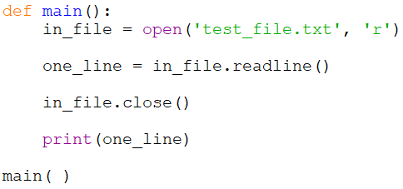
Chapter 7 File Operations
Reading from a File
The example reads a single line from the file into the variable file_data, closes the file, and prints the variable

Slide 25
Chapter 7 File Operations
Reading Numeric Data from a File
When reading numeric values from a file, they are returned as strings
Must be converted to a numeric data type in order to use them as a numeric value
Chapter 3 introduced casting for type conversion which is used when reading from a file
The data format in the file may cause issues when casting

Slide 26
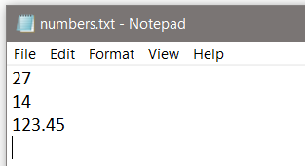
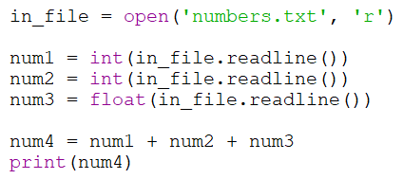
Chapter 7 File Operations
Reading Numeric Data from a File
Since Readline reads until the line feed, there is no issue here

Slide 27
Chapter 7 File Operations
Reading Data from a File
Typically, a loop is used when handling file data
One option is to read a line or value, process the data, and output some result
The loop continues to read until there are no more values
Every file contains an end of file (EOF) marker that indicates where the file ends
When it is reached, a value cannot be read by the Python method being used
This ends the loop that is reading from the file

Slide 28
Chapter 7 File Operations
Reading Data from a File
Another option is to read the entire file into a string, and use the loop to parse the string
The loop continues to process until there are no more values
The parsing algorithm is dependent upon the data format
The file data format affects the parsing algorithm

Slide 29
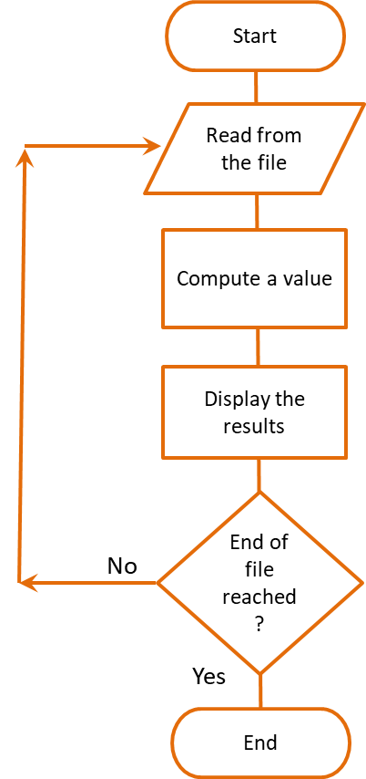
Chapter 7 File Operations
Reading from a File
File Reading Code and Flowchart

Slide 30
Chapter 7 File Operations
Reading Data from a File
The algorithm used to read and process file data is dependent to a large degree on the format of the data in the file
Therefore, how the data will be read and processed is a consideration when designing the writing format
One value per line
Columnar data with tabs between values
Values separated by a character or space

Slide 31
Chapter 7 File Operations
Reading Delimited Data from a File
A delimiter is a character used to mark the beginning or end of an item of data
Consider a file written with columnar data with tabs between the values (tab-delimited data)
Using read() or readline() would include the delimiter (tabs in this case) in the returned string
It is common to read files one line at a time in a loop and process the data
Python has several methods that help to convert the data to a useful format

Slide 32
Chapter 7 File Operations
Reading Files - Removing Characters
When Python reads from a file, the data is returned as a string and may include tabs, line feeds, and spaces
To remove tabs, line feeds, and spaces, there are several string modification methods including:
rstrip - removes white space (\n, \t, and space) from the right side of the string
lstrip - removes white space (\n, \t, and space) from the leading side of the string

Slide 33
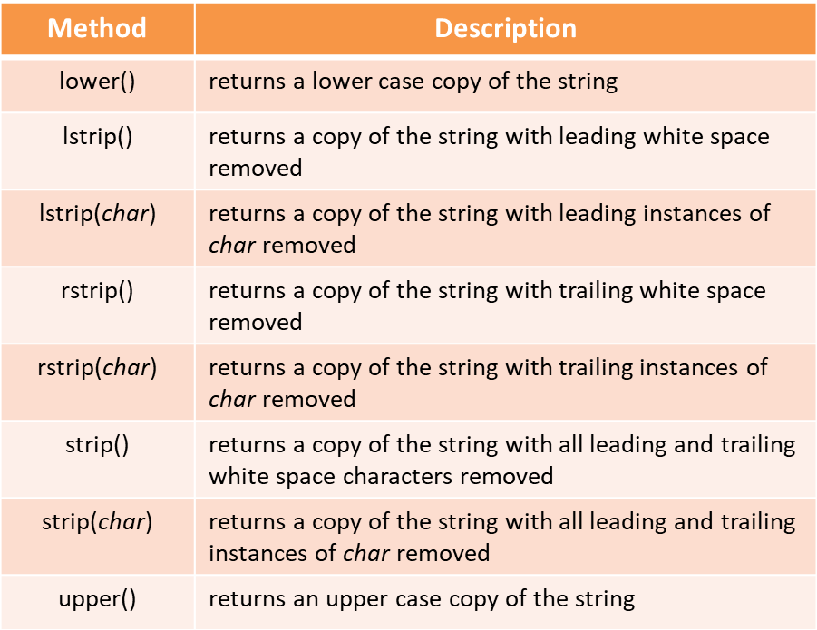
Chapter 7 File Operations
String Modification Methods

Slide 34
Chapter 7 File Operations
String Modification Methods
Used to convert what has been read into a usable format and ensure that white space characters are not part of any data being converted to a numeric value
There is also a split() method that can split (parse) a line of data using a delimiter
The default delimiter for split() is any white space, but another character can be used

Slide 35
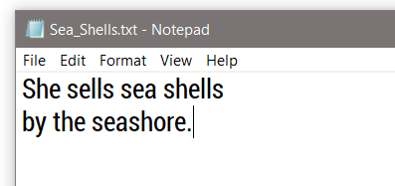
Chapter 7 File Operations
Split example
A data file contains the phrase “She sells sea shells by the seashore” on two lines
The entire file will be read into a string
The split() method will extract each word because the default split character is whitespace (tabs, line feeds, spaces)

Slide 36
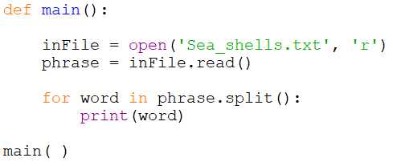
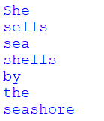
Chapter 7 File Operations
Split example
The entire file is read into the variable phrase
The split() method extracts each word in a loop

Slide 37
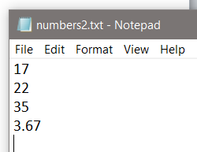
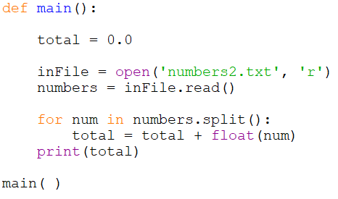
Chapter 7 File Operations
Split Example – Numeric Data
This example reads the entire file into ‘numbers’, and then uses split to separate them

Slide 38
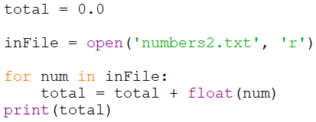
Chapter 7 File Operations
Split Example – Numeric Data
Notice that the file can be read directly one item at a time using a for-in loop (the line feeds are not an issue)

Slide 39
Chapter 7 File Operations
Which technique to use
The technique used for reading and handling data from a file is often dependent upon the data format and the processing required
The data can be read one item or line at a time
The entire contents can be read at once
A loop can be used to read the data or to extract the individual values
The best technique may depend on the format of the file data

Slide 40
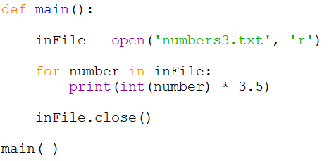
Chapter 7 File Operations
Reading using a loop
A loop can read and process without storing the items in a separate variable before handling them

Slide 41
Chapter 7 File Operations
File handling issues
When a designing and developing a program that uses files, consider what happens if:
The file that the program reads from does not exist
The file that the program reads from cannot be opened
The file that the program reads from is corrupted
The file the program writes to cannot be created
The user does not have permission to create files
There is not enough room on the drive to create a file

Slide 42
Chapter 7 File Operations
Exceptions
When a file cannot be created or cannot be opened, or when there is a data type mismatch, an exception will be raised (thrown) by the program
An exception is a type of error that occurs when a program is running
An exception must be handled or the program will terminate

Slide 43
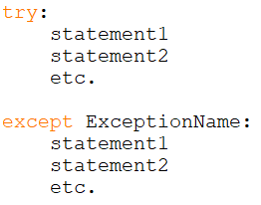
Chapter 7 File Operations
Exceptions
The format for an exception handler in Python is the try/except statement
statements
that may raise
an exception
statements
to execute if an
exception is
raised

Slide 44
Chapter 7 File Operations
Exceptions
The try block is entered and if a statement raises an exception, the handler immediately following the except clause that matches the type of exception raised executes and the program continues

Slide 45
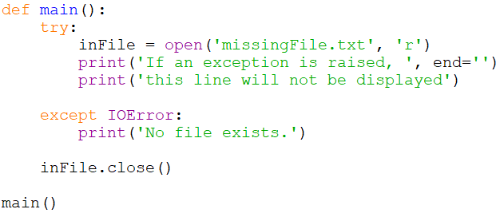
Chapter 7 File Operations
Exceptions – File Not Found
The code below could be stated:
Try to open the file, and if an IOError occurs print “No file exists.”

Slide 46
Chapter 7 File Operations
Exceptions – File Not Found
The exception name is IOError which is the type of exception that would be raised if the file did not exist or could not be opened

Slide 47
Chapter 7 File Operations
Exceptions – File Not Found
Once an exception is raised, the try block is exited and any statements following the one that raised the exception will not be executed

Slide 48
Chapter 7 File Operations
Exceptions – Other Types
Each type of exception that could be raised should have an exception handler for that specific exception
An exception that is not handled will halt the program
An exception clause that does not list a specific exception, will handle any exception that is raised in the try suite
This could be considered a default handler
An exception that is not handled will halt program execution

Slide 49
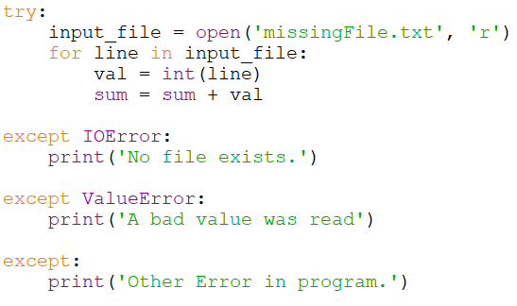
Chapter 7 File Operations
Exceptions – Other Types
The two anticipated exceptions are a file error and a type error
default handler

Slide 50
Chapter 7 File Operations
Exceptions
An exception raised is actually an object and contains information about the error
The contents is the same message that would be seen in the trace back error message
Can be accessed by assigning the exception to a variable
except ValueError as e:
print(e)

Slide 51
Chapter 7 File Operations
Exceptions
The try-except suite can include an else clause
Executes only if no exceptions were raised
If an exception is raised, then the else clause is skipped
“try to execute these, and if an exception is raised, execute the exception handler, otherwise execute these”.

Slide 52
Chapter 7 File Operations
Exceptions
There is also an optional finally clause
Executes regardless of whether an exception was raised or not to perform cleanup
If a try suite opens a file and then executes other statements, one of those other statements may throw an exception
But the file is still open
A finally suite allows closing the file, or any other cleanup needed whether an exception was raised or not

Slide 53
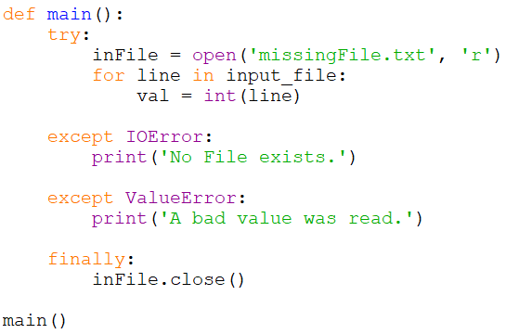
Chapter 7 File Operations
The finally clause (or finally suite)

Slide 54
Chapter 7 File Operations
File Selection
Dialog boxes can simplify file handling when a user is selecting a file
Rather than have a user type a file name or path to a file, the dialog allows selection
This avoids typographical errors, and the dialog only displays files that exist

Slide 55
Chapter 7 File Operations
File Dialogs – Open File
The tkinter module provides dialogs for handling files
Using them requires the specific import statement shown below

Slide 56
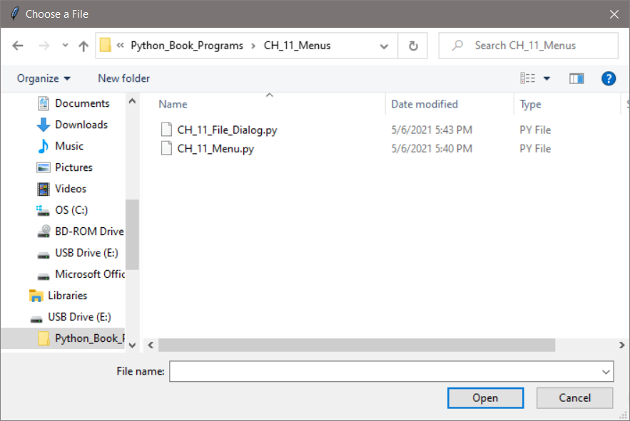
Chapter 7 File Operations
File Dialogs – Open File Dialog
When the dialog appears, the default directory is the directory where the program is running

Slide 57
Chapter 7 File Operations
File Dialogs – Open File
When a file is selected, the dialog returns a string containing the full path to the file including the name of the file
The string is used to open the file

Slide 58
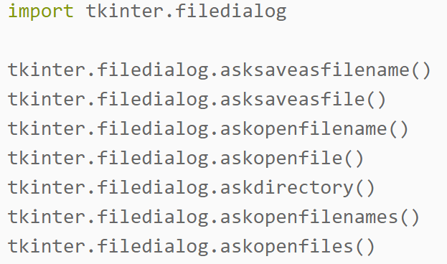
Chapter 7 File Operations
File Dialogs
Tkinter provides Save and Save As dialogs among others

Slide 59
Chapter 7 File Operations
Chapter 7 File Operations

