Slide 1
Computer Programming in Python
Chapter 4
Decisions and Boolean Logic

Slide 2
Chapter 4 Decisions and Boolean Logic
Decision (Control) Structures
Determine the statements that execute based upon whether or not a condition is true
A conditional statement is used to determine whether or not a line or lines of code execute
Decisions are based on a True or False condition

Slide 3
Chapter 4 Decisions and Boolean Logic
Decision (Control) Structures
Conditional statements provide multiple paths through a program based on the status of Boolean (true or false) conditions
If the condition is true, then a statement or statements are executed
Otherwise they are not executed
The program path is based on a True or False condition

Slide 4
Chapter 4 Decisions and Boolean Logic
Example:
A Theater has seating for 400 participants
Once the Theater has sold 400 tickets, the show has been sold out
When this occurs, the Theater displays a “Sold Out” sign at the box office
If 400 tickets have been sold
Display the “Sold Out” sign
City Theater
Sorry
Sold Out

Slide 5
Chapter 4 Decisions and Boolean Logic
Decision Structures
Example:
If 400 tickets have been sold
Display the “Sold Out” sign
The condition is tested (have 400 tickets been sold)
If it is true, then the “Sold Out” sign is displayed
If the condition is false and 400 tickets have not been sold, then the sign will not be displayed.

Slide 6
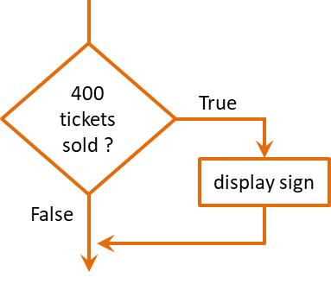
Chapter 4 Decisions and Boolean Logic
Decision Structures
Represented in flowcharts using diamonds
The different paths that the program can take are shown using lines from the corners of the diamond with arrows indicating the direction with text to indicate the result

Slide 7
Chapter 4 Decisions and Boolean Logic
Decision Structures
If the condition is true, then follow the path to display the sign
Otherwise (if it is false), the program continues
These paths are the Flow of Control or Order of Operations

Slide 8
Chapter 4 Decisions and Boolean Logic
The ‘if’ statement
The conditional statement begins with the word if, followed by the condition, and ends with a colon
This is often referred to as the “if clause”
The statement to be executed based upon the condition is below the condition and indented (one tab space)

Slide 9
Chapter 4 Decisions and Boolean Logic
The ‘if’ statement
The interpreter associates the indented statement with the condition
If the condition is true, the statement will be executed
If the condition is false, then the statement will be skipped

Slide 10
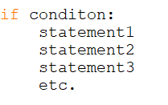
Chapter 4 Decisions and Boolean Logic
The ‘if’ statement
Multiple statements can be associated with a condition and form what is commonly referred to as a block of code
A group of associated statements
Multiple indented statements form a Block of Code

Slide 11
Chapter 4 Decisions and Boolean Logic
The ‘if’ statement
If the condition is true, all of the indented statements (the block of code) will be executed
If the condition is false, all of the indented statements will be skipped by the interpreter

Slide 12
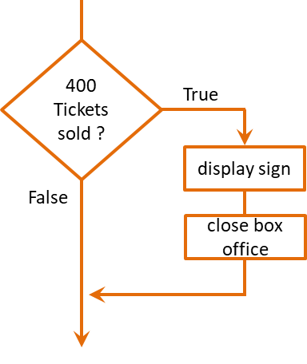
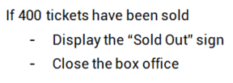
Chapter 4 Decisions and Boolean Logic
The Theater example continued:
Assume that when the show is sold out, in addition to the sold out sign being displayed, the box office is closed

Slide 13
Chapter 4 Decisions and Boolean Logic
Boolean Expressions
Conditional statements are either True or False
Referred to as Boolean Expressions
Named after George Boole
Implemented using Relational Operators
A value can either be equal to another, greater than another, or less than another

Slide 14
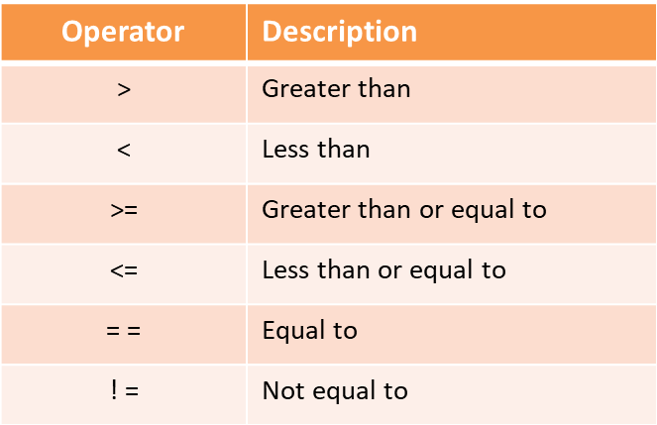
Chapter 4 Decisions and Boolean Logic
Relational operators
Used to test the relationship between items to determine the next step for the program

Slide 15
Chapter 4 Decisions and Boolean Logic
The Theater example continued:
A Boolean expression with a relational operator would be used in the conditional statement for the code
The number of tickets sold is either 400 or it is not
The expression is True or it is False

Slide 16
Chapter 4 Decisions and Boolean Logic
Conditional Expressions
To allow for another option the else clause is used
An else clause can be thought of as an “otherwise” condition for when the relational expression is not true
In other words
If this is true:
Then do this
else (otherwise):
Do this

Slide 17
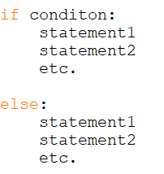
Chapter 4 Decisions and Boolean Logic
Conditional Expressions
When the “if” condition is true, the statements in the “if” block will be executed and the “else” block will be skipped
When the “if” condition is false, the “if” block will be skipped and the “else” block will execute

Slide 18
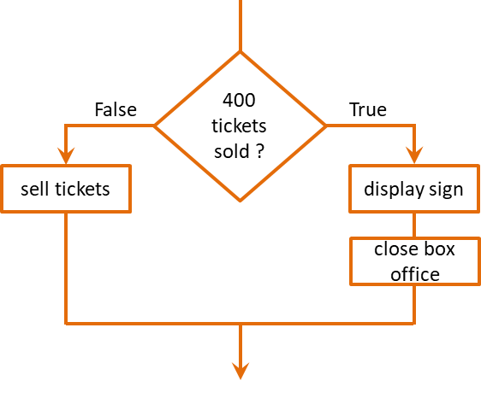
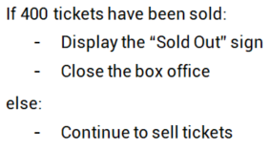
Chapter 4 Decisions and Boolean Logic
Conditional Expressions
The Theater example continued:

Slide 19
Chapter 4 Decisions and Boolean Logic
Conditional Expressions
The Theater example continued:

Slide 20
Chapter 4 Decisions and Boolean Logic
Conditional Expressions
When there are two conditions that must be tested, a second if clause can be added after the first
If this is true:
Then if this is true:
Do this

Slide 21
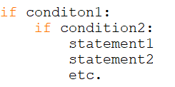
Chapter 4 Decisions and Boolean Logic
Conditional Expressions
A nested if is an if clause within another if clause
If condition1 is false, then condition2 will not be tested and the statements are skipped

Slide 22
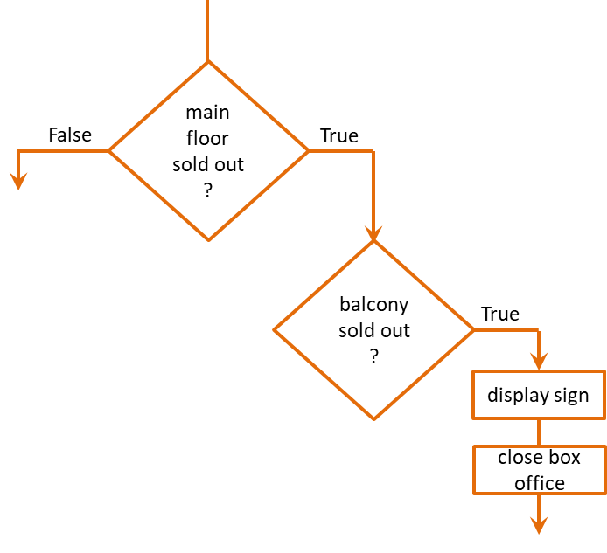
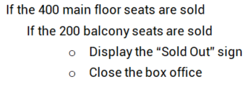
Chapter 4 Decisions and Boolean Logic
Conditional Expressions
A nested if in the Theater example:
Consider a balcony section with 200 seats

Slide 23
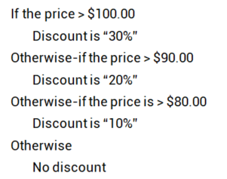
Chapter 4 Decisions and Boolean Logic
An if-elif-else provides additional paths
The logic only tests a condition if the condition before it is false
The third condition is only tested if the first and second conditions are false
if
elif
elif
else

Slide 24
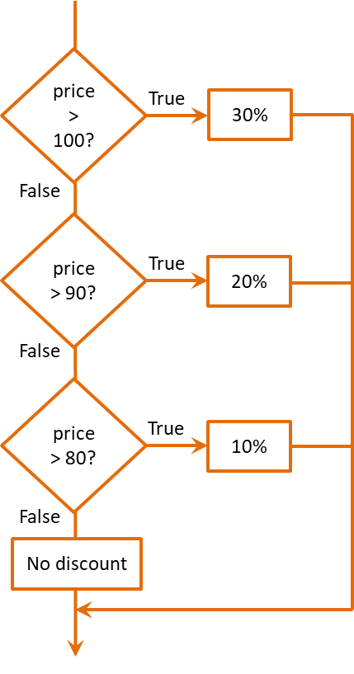
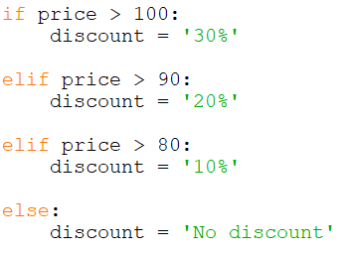
Chapter 4 Decisions and Boolean Logic
Conditional Expressions
An if-elif-else

Slide 25
Chapter 4 Decisions and Boolean Logic
Conditional Expressions
and
Boolean Logic

Slide 26
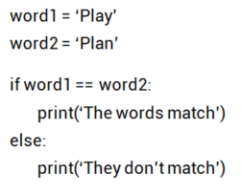
Chapter 4 Decisions and Boolean Logic
Conditional Expressions - Comparing strings
Use the equivalence operator
tests for equivalence

Slide 27
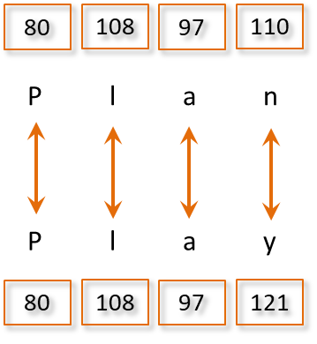
Chapter 4 Decisions and Boolean Logic
Conditional Expressions – Comparing Strings
Compared using the ASCII representation

Slide 28
Chapter 4 Decisions and Boolean Logic
Compound Boolean Expressions
Multiple conditions can be combined using the ‘and’ and ‘or’ Logical Operators
For an expression to be true:
Logical and, both conditions must be true
Logical or, either condition must be true
Logical not operator negates the result

Slide 29
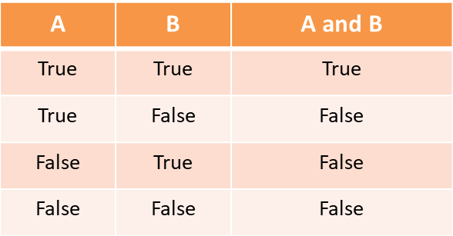
Chapter 4 Decisions and Boolean Logic
Logical and operator
Both conditions must be true for the expression to be true

Slide 30
Chapter 4 Decisions and Boolean Logic
Logical and operator
Both conditions must be true for the expression to be true

Slide 31
Chapter 4 Decisions and Boolean Logic
Logical and operator
Testing within a range
Useful for input validation
Validating input within a range of numbers

Slide 32
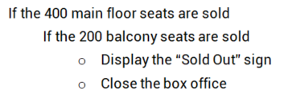
Chapter 4 Decisions and Boolean Logic
Compound Boolean Expressions
The Theater example continued:

Slide 33
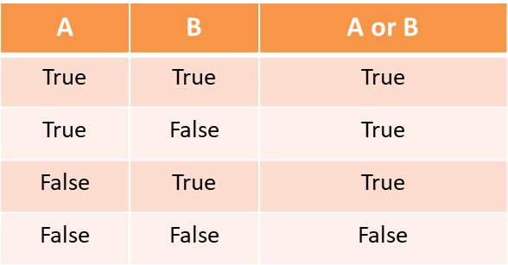
Chapter 4 Decisions and Boolean Logic
Logical or operator
If either condition is true, the expression is true

Slide 34
Chapter 4 Decisions and Boolean Logic
Logical or operator
If either condition is true, the expression is true

Slide 35
Chapter 4 Decisions and Boolean Logic
Logical or operator
Testing a range
Useful for input validation

Slide 36
Chapter 4 Decisions and Boolean Logic
Computers use what is called short-circuit evaluation
For a Logical “and” to be true, both sides of the compound condition must be true
If the left side is false, then the right side is not evaluated
It wouldn’t matter if the right side were true since the expression is already false

Slide 37
Chapter 4 Decisions and Boolean Logic
Computers use what is called short-circuit evaluation
For a Logical “or” to be true, either side of the compound condition can be true
If the left side of the compound condition is true, the right side is not evaluated
It wouldn’t matter whether the right side is true or false since the expression is already true

Slide 38
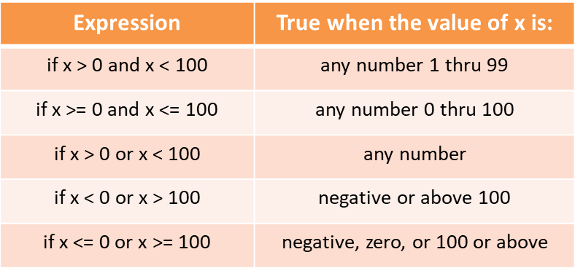
Chapter 4 Decisions and Boolean Logic
Common Logic Errors
Conditional statements require careful consideration

Slide 39
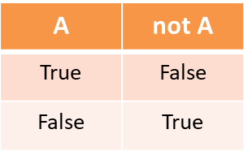
Chapter 4 Decisions and Boolean Logic
Logical not
Returns the reverse of the condition
Often cause confusion and hard-to-find bugs

Slide 40
Chapter 4 Decisions and Boolean Logic
Compound Boolean Expressions
Logical not
Often easier to reverse the logic
De Morgan’s Law provides two forms: one for negation of an “and” expression and one for an “or” expression
! (A and B) !A or !B
! (A or B) !A and !B

Slide 41
Chapter 4 Decisions and Boolean Logic
Boolean Variables
the bool data type in Python
Operates as true or false
Often used as flags or signals in code when something has occurred or a condition has been met
Can be used in conditional statements

Slide 42
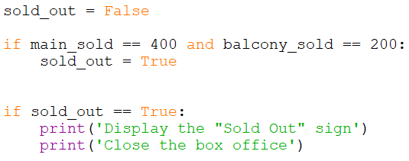
Chapter 4 Decisions and Boolean Logic
Boolean Variables
The example below sets a Boolean variable to false, then changes it to true when enough tickets have been sold

Slide 43
Chapter 4 Decisions and Boolean Logic
Boolean Variables
The equivalence operator and true, is not required
This: if sold_out == True:
Is the same as: if sold_out:
The logic can also be reversed
This: if sold_out == False:
Is the same as: if not sold_out:

Slide 44
Chapter 4 Decisions and Boolean Logic
Common Errors
Writing conditional expressions
Always test around the threshold
if value < 90 # excludes 90
if value <= 90 # includes 90
Use two (2) equal signs to test for equivalence
value = num # assigns num to value
value == num # tests for equivalence

Slide 45
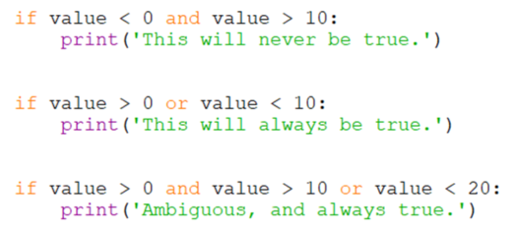
Chapter 4 Decisions and Boolean Logic
Common Errors
Writing conditional expressions

Slide 46
Chapter 4 Decisions and Boolean Logic
Common Errors
Not indenting correctly
The interpreter relies on indentation to associate lines of code

Slide 47
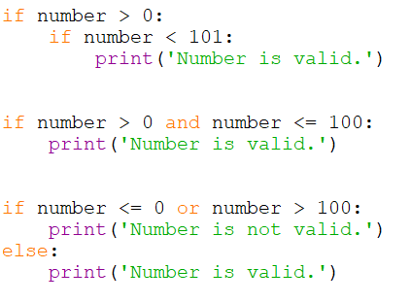
Chapter 4 Decisions and Boolean Logic
Programmer Choice
Each of these accomplish the same thing

Slide 48
Chapter 4 Decisions and Boolean Logic
Avoiding Common Errors
The interpreter will catch errors in syntax and grammar
Logic errors can only be avoided by careful implementation of the code
The best solution may be more deliberate and intentional than the use of complex statements
It is also a fact that code is written once, but read many times, so readability is always a consideration

Slide 49
Chapter 4 Decisions and Boolean Logic
Chapter 4 Decisions and Boolean Logic

