Slide 1
Faculty Workshop: OER

Slide 2
What We’ll Review in this Presentation
What is OER?
The 5 Rs
Examples of OER
Finding existing OER
Modifying OER
Creating OER
Adopting OER
How are our peer institutions using OER?
Creative Commons
Notes, Q&A

Slide 3
What is an OER
Creative Commons defines OER as:
“Open Educational Resources (OER) are teaching, learning, and research materials that are either
In the Public Domain
Licensed in a manner that provides everyone with free and perpetual permission to engage in the 5R activities.”

Slide 4
What are the 5Rs of OER?
Retain- make, own, and control a copy of the resource.
Reuse- use your original, revised, or remixed copy of the resource publicly.
Revise- edit, adapt, and modify your copy of the resource.
Remix- combine your original or revised copy of the resource with other existing material to create something new.
Redistribute- share copies of your original, revised, or remixed copy of the resource with others.

Slide 5
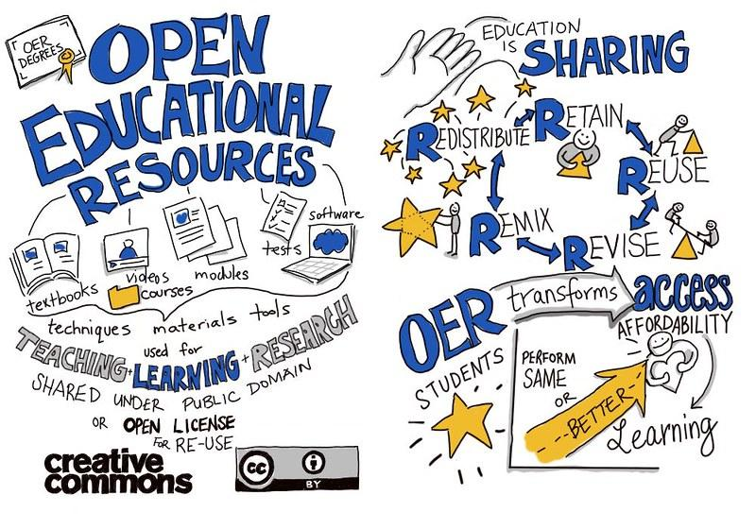
Examples of OER
Activities
Labs
Case Studies
Games
Interactive work
Lecture notes
Textbooks
Lesson plans
Modules
Other resources
https://flic.kr/p/212JrPx

Slide 6
Finding existing OERs
The Internet is awash in OER TEXTBOOK resources. Here are some we’ve used successfully (Use these or add your own).
OER Commons
OpenNJ
Open Stax
Open Textbook Library
Skills Commons

Slide 7
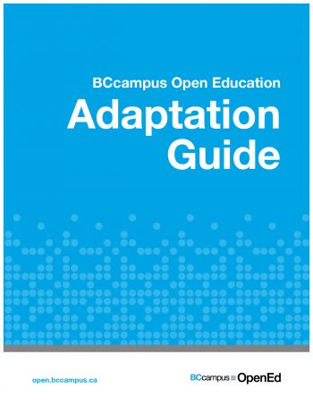
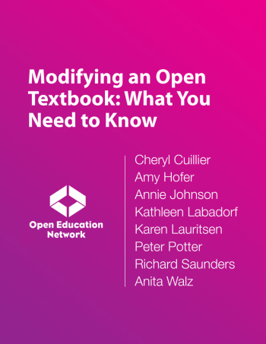
Modifying OERs
Information on how OERs can be modified and adapted and why that is useful (modify based on your needs).

Slide 8
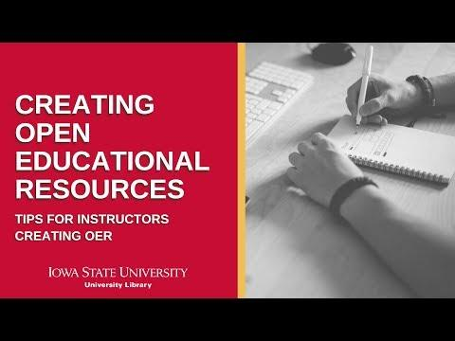
Creating OERs
Information on how and why new OERs are created (add your own).
"Creating Open Educational Resources" by Abbey Elder is licensed under a Creative Commons BY 4.0 International license: https://creativecommons.org/licenses/...

Slide 9
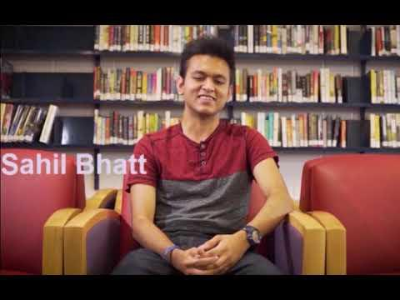
Adopting OERs
Information on how OERs have been adopted by faculty at your or a sister institution (add your own video).
“Welcome to Open OER at Rowan College New Jersey” by Rowan University is licensed under Creative Commons Attribution NonCommercial Sharealike 4.0 International: https://creativecommons.org/licenses/by-nc-sa/4.0/

Slide 10
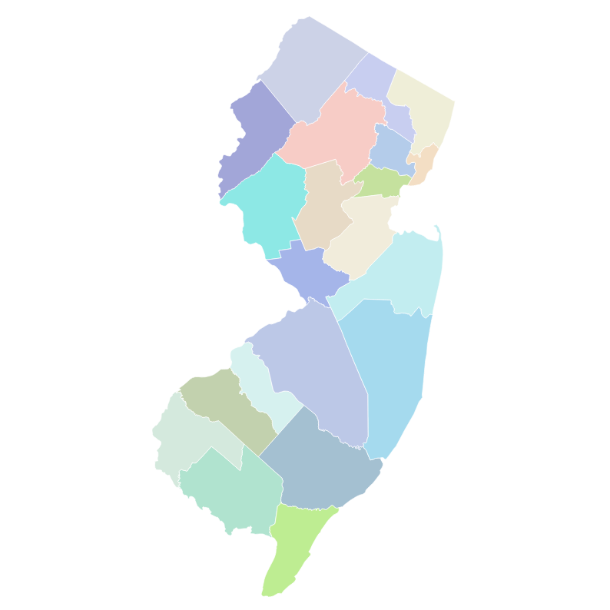
How [blank] NJ institution is already using OER’s or future plans
This will be a template for users to add their own videos or information about OERs on their campus, or OER committees/groups that are working on OERs.
Hudson County Community College’s OER LibGuide
Rowan College at Burlington County LibGuide

Slide 11
Now what?
Now that you understand what OER is and have gathered your materials that you would like to publish, then you’ll need to determine which Creative Commons license you’ll be publishing your materials under.

Slide 12
Creative Commons
The Creative Commons (CC) Licenses provides creators and institutions with a standardized way of granting the public permission to reuse their creative work.

Slide 13
The Six CC (Creative Commons) Licenses
CC BY: Allows individuals to distribute, remix, adapt, and build upon the material in any way and manner. The only stipulation is that the reuser properly attribute the creator.
CC BY-SA: This license builds upon BY, by allowing the commercial use of the material.
CC BY-NC: The license builds upon BY, by ensuring that the non-commercial reuse of the licensed material.

Slide 14
Continued…
CC BY-NC-SA: This license builds upon the rules outlined by the BY and NC category as listed above by forcing reused to redistribute their material under identical CC terms.
CC BY-ND: This license allows for redistribution and commercial use of materials in an unadapted form, with attribution to the creator.
CC BY-NC-ND: This license follows the terms outlined in the BY-ND, with the addition of prohibiting reusers from redistribute the material for commercial purposes.

Slide 15
The Creative Commons Public Domain Dedication (aka CC Zero)
CCo: This license allows creators to give up their copyright and put their works into the worldwide public domain.

Slide 16
Other resources
Introductory Resources
https://opencontent.org/definition/
https://wiki.creativecommons.org/wiki/What_is_OER%3F
https://www.youtube.com/watch?v=qc2ovlU9Ndk
https://www.youtube.com/watch?v=-xGRztrWv-k
Modifying and Creating OERs
https://www.wcl.american.edu/impact/initiatives-programs/pijip/documents/code-of-best-practices-in-fair-use-for-open-educational-resources/
https://youtu.be/KcvYG-rkO-Y
https://iastate.pressbooks.pub/oerstarterkit/chapter/open-pedagogy/

Slide 17
Contact
James Cox, Hudson County Community College, jcox@hccc.edu, 201-360-4354
Amanda Cowell, The College of New Jersey, cowella@tcnj.edu, 609-771-2159
Michael D’Agostino, Rowan College at Burlington County, mdagostino@rcbc.edu, 856-285-4913
This work is licensed under a Creative Commons Attribution 4.0 International License.

