Slide 1
OTC OER Training
Module 1: Understanding OER
Module 2: Open Licensing
Module 3: Creative Commons Licensing
Module 4: Adapting, Creating, & Sharing OER
OTC OER Training 2021 adapted from Texas Learn OER by Carrie Gits for DigiTex under a Creative Commons Attribution 4.0 International License (CC BY) and is licensed under a Creative Commons Attribution-NonCommercial 4.0 International License (CC BY-NC 4.0).

Slide 2
Module 3: Creative Commons Licensing
Adapted from “Module 7” Texas Learn OER by Carrie Gits for DigiTex under a Creative Commons Attribution 4.0 International License CC BY 2020

Slide 3
Learning Objectives
By the end of this module, you will be able to:
Identify the differences between the six currently available Creative Commons licenses
Identify the conditions including attributions when using open licensed material
Recognize how different license permissions impact remixing compatibility
Use tools to guide you in choosing the appropriate license for your own work
Use tools for creating attribution statements in your work

Slide 4
Creative Commons Licensing
Creative Commons (CC) licensing is at the heart of the OER movement.
CC allows creators to specify more flexible forms of copyright that allows others to copy, distribute, and make some uses of their work.
Look for copyright information (often at the bottom of webpages).
Creative Commons licensed material online often displays clickable icons that indicate the specifics of licensing.
See the Creative Commons website for more info and to generate licenses and icons.

Slide 5
CCBY, CCBYSA, CCBYNC, CCBYNCSA, CCBYNCND
The acronyms above are representative of the six different Creative Commons (CC) licenses.
Open licenses differ from all rights reserved copyright. In this module, you will learn about the different conditions and permissions of these licenses.
Creative Commons Licensing, The 5Rs, and OER: The Shortest Possible Introduction
This short slide show presentation provides the nuts and bolts of creative commons licenses and their conditions. Review the presentation first, including the embedded video. Then, come back to this module and continue learning.

Slide 6
Six Licenses
There are six different Creative Commons (CC) licenses that are useful combinations of conditions
All including the primary condition of Attribution.
Understanding the meaning of each condition can be useful when deciding which CC license to use on your own work.
Understanding the meaning of the conditions can also be useful in evaluating an open resource.

Slide 7
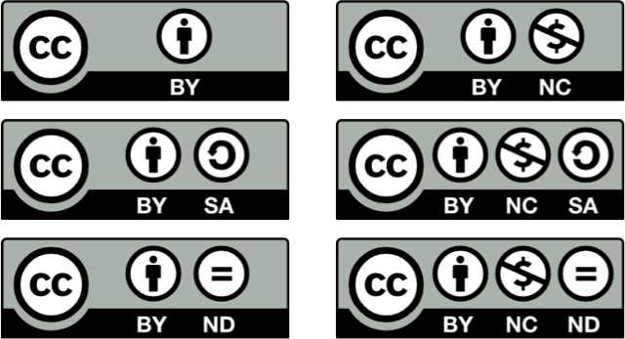

Slide 8
The Conditions

Slide 9
Attribution (BY)
The Attribution (BY) condition is fundamental to all CC licenses. What many creators care about most is receiving credit for their creative work.
When reusing CC-licensed work, proper attribution must be given to the original creator — and to other contributors on the work, if any. The CC BY license is the most open of all the licenses and allows for the most re-use.

Slide 10
Share-Alike (SA)
The Share-Alike condition adds a requirement for anyone reusing your work to also license their own creation (based on your work) under the same license. Both the CC BY-SA and CC BY-NC-SA licenses include this condition, effectively making them ‘copyleft’ or ‘viral’ licenses.
While this condition effectively “locks open” the content, remixing SA content with non-SA or other-SA licensed work may not be straightforward or allowed at all.

Slide 11
Non-Commercial (NC)
The Non-Commercial condition allows for reuse and sharing but reserves commercial rights for the creator. The meaning of the NC condition itself and its ability to prevent commercial reuse is not always clear, but the license condition does clearly indicate that commercial reuse rights are not being granted.

Slide 12
No-Derivatives (ND)
The No-Derivatives condition allows sharing and reuse but only if the content is left unchanged. This presents an issue when searching for OER, as no customization or adaptation is allowed by the license. For this reason, ND content is not considered OER and should be considered for reuse only in situations where no adaptations are needed.

Slide 13
Combining the Conditions
The BY (attribution) condition is a part of all the licenses, but not all of them work together.
For example, the SA and ND conditions do not appear in the same license because there is no reason to include the share-alike condition when no derivatives are being allowed. Together, the conditions form the six CC licenses:
As you find different types of OER to use in your courses, you may find the need to remix and modify the content.
Understanding how the different licenses can or cannot be combined is a critical step in reusing openly licensed material. The license compatibility chart is a great resource in determining which licenses work together.

Slide 14
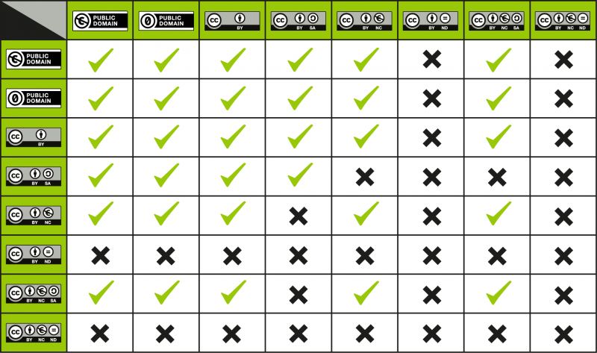
"License Compatibility Chart" by Creative Commons is licensed under CC BY 4.0

Slide 15
Giving Credit Where Credit is Due
All six of the Creative Commons licenses include the BY or attribution condition.
This is a requirement of reuse. The original creator has explicitly informed the user of this requirement through the use of the BY condition.
As you learned in the slide show presentation earlier in this module, citations and attributions are similar but different.
Providing attribution is the legal requirement of the open license. While some tools, like CC Search, include the attribution in the resource, there are other tools available to help users easily create attribution statements for work they reuse, remix, or modify.

Slide 16
How to Give Attribution
Attribution Builder - created by Open Washington, this tool, similar to a citation generator, builds attribution statements that can be copied and pasted into documents and websites.
When creating attribution statements, a good rule of thumb is to remember the acronym TASL:
Title of the work
Author of the work
Source or where the work can be found
License of the work

Slide 17
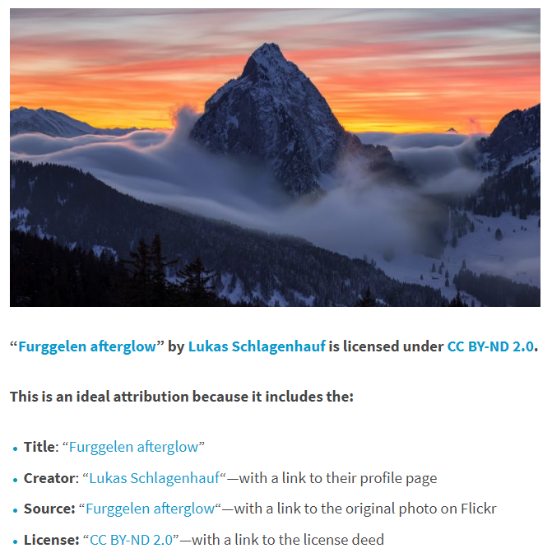
CC Attribution
Screenshot from “How to Give Attribution” by Creative Commons
More: Best Practices for Attribution

Slide 18
Citation vs. Attribution
Citation and attribution serve different purposes.
Citation is used for academic reasons in order to give credit to a colleague for their work as part of academic integrity. It’s also used for legal reasons.
Attributing an open work fulfills the legal requirement of the open-copyright license, which requires you to give credit to the creator of the work.
Learn more about Citation vs. Attribution in the BCcampus Self Publishing Guide.
Self-Publishing Guide by BCcampus is licensed under a Creative Commons Attribution 4.0 International License, except where otherwise noted.

Slide 19
Choosing A License For Your Work
When sharing your work, selecting and displaying a license with it ensures the work can be adopted and adapted how you want! If you don't select a license, all published material may be assumed to be all rights reserved even if you intended it to be openly licensed.
When creating work to share, carefully consider how you want your work to be used when choosing which open license to apply. As the original creator of your work, you have choices.
Do you want to allow derivatives?
Do you want to allow for commercial purposes?
Do you want the same license to be applied on derivatives?
If this work was made using openly licensed material, is there a copyright provision you must abide?

Slide 20
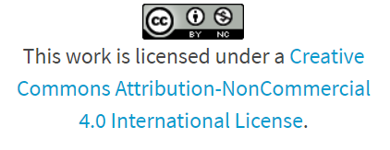
CC License Chooser
The CC License chooser is a simple tool designed to help creators decide which license is best for their work.
Remember, when remixing content to create something new, if any of your adapted content includes the SA (share alike) condition - you must apply the SA condition to your newly remixed finished work.
Visit the CC license chooser. With two questions the tool will prompt you to select conditions for sharing your work. A license icon, statement, and code to embed is generated for you to easily copy and paste into your work.

Slide 21
Module 3 Review
True or False: The four Creative Commons conditions are: Attribution, Share Alike, Non-Commercial, No-Derivatives
True or False: When reusing any work with a creative commons license, attribution is suggested, but not required as part of the license condition.
Using the Attribution Builder, generate an attribution statement for the following linked image: Think! by Christian Weidinger

Slide 22
Review
Select the 5 R’s below
Retain, Reuse, Revise, Remix, Redistribute
Reform, Reputable, Redistribute, Remix, Restrict
Reputable, Revise, Remix, Reuse, Recommended
Recommended, Redistribute, Revise, Remix, Retain
Retain, Reuse, Revise, Remix, Reputable
If a work is labeled CC-BY-ND, this means
I cannot use this work as it is copyrighted all rights reserved
Since this work has an open copyright (creative commons) license, I can use it in any way and do not need an attribution to the creator
Although this work has an open (creative commons) copyright license, I can use it as long as I attribute the creator and do not sell it
Although this work has an open (creative commons) copyright license, I can use it as long as I attribute the creator and make no changes to the work

Slide 23
Review
The following term is used to describe the belief that the public is entitled to freely use portions of a copyrighted work for commentary or criticism
Public Domain
Fair Use
Creative Commons
All Rights Reserved
This image means:
A work is in the public domain
This work is copyrighted all rights reserved
This is a Creative Commons open license and means the work is free to use in any way and you do not need to attribute the creator
This is a Creative Commons open license and meant the work is free to use in any way, however, you must give attribution to the creator of the work

Slide 24
Review
You are remixing content to build an educational resource that is openly licensed, CC-BY. Which type of materials can you use? Select all that apply
Public domain
Fair use
Original work I created
CC BY-SA-ND
CC BY

Slide 25
Remember! Open = Free + Permissions
Everything that is Open is Free, but not everything that is Free is Open.

Slide 26
Further Reading
Code of Best Practices in Fair Use for Open Educational Resources
Creative Commons NonCommercial license. (Jan 2021). In Wikipedia.
Kline, D., Kappos, D. (2021). The Basics of Copyright. In Introduction to Intellectual Property. OpenStax.
Stanford Libraries. Welcome to the Public Domain. Copyright & Fair Use.

