Slide 1
Open Textbook Collaborative Information Session
Funded by a Grant awarded through the US Department of Education FIPSE Program
[OTC Project Team]
[Hosted by the NJCCC Center for Student Success]
[11/5/2021]
by Marilyn N. Ochoa
Notes:
“Furggelen afterglow” by Lukas Schlagenhauf is licensed under CC BY-ND 2.0.

Slide 2
Agenda
Project Overview & Goals
Opportunities for Participation
Workflow
Currently Funded Proposals
Q&A in Industry Area Breakout Rooms

Slide 3
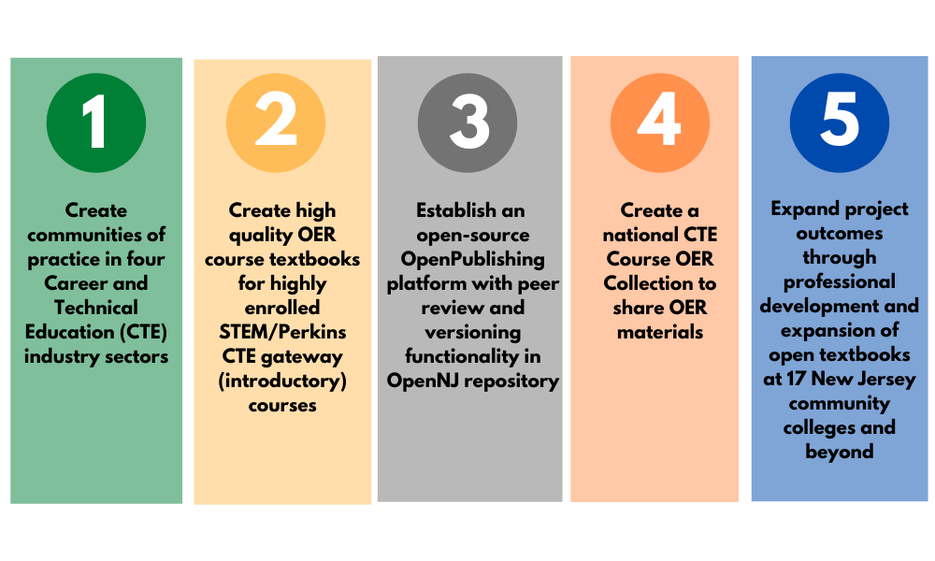
Open Textbook Collaborative Goals

Slide 4
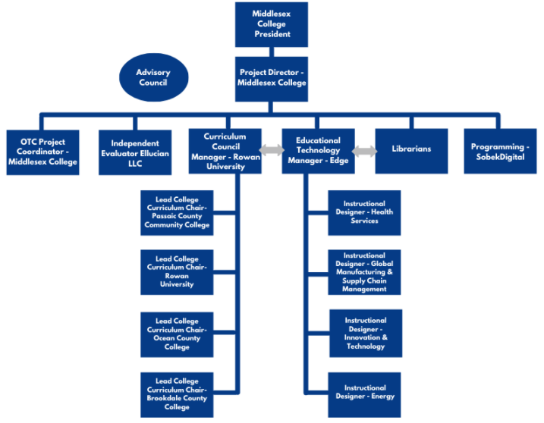
Project Overview
Notes:
Create communities of practice to discuss and define industry standards and trends along with curriculum gaps in four Career and Technical Education (CTE) industry sectors to decrease cost of college and increase student success
Create high quality OER course textbooks for highly enrolled STEM/CTE gateway (introductory) courses to decrease cost of college and increase student success
Establish an open-source publishing platform with peer review and versioning functionality in OpenNJ repository
Create a national CTE Course OER Collection to share course OER materials
Expand project outcomes through professional development and expansion of open textbooks at 17 New Jersey community colleges and beyond

Slide 5
Growth Industries and College Leads
Growth Industry | Lead College
Global Manufacturing & Supply Chain Management | Passaic County Community College
Innovation & Technology | Ocean County College
Health Services | Brookdale Community College
Energy | Rowan University
Notes:
Jake to do

Slide 6
Opportunities for Participation
Participate in Curriculum Committee (industry-focused)
Participate in Advisory Committee (strategic)
Recommend potential subject specialists in industry areas
Apply to write OER textbook or ancillaries in specific industries
Include already existing OER in OpenNJ statewide repository
Participate in project evaluation and usability testing of OpenPublishing tools
Attend OER workshops and other professional development opportunities
Disseminate information about OTC project opportunities
Adopt or adapt OER
Notes:
This slide shows the multiple ways to become involved in the OTC with Decision making, content creation, and dissemination and use. Today’s focus is on developing communities of practice that will lead to the submission of content proposals and participation with curricular and content decisions.

Slide 7
Industry Areas and Initial Courses
Growth Industry | Proposed Courses
Global Manufacturing & Supply Chain Management | Principles of Economics I Analytic Geometry and Calculus I Business Law I NEW: Introduction to Supply Chain Management
Innovation & Technology | Data Structures and Analysis Introduction to Computers and Computer Applications Introduction to Computer Programming: Java Introduction to Computer Programming: Python
Health Services | Human Anatomy and Physiology I Introduction to Organic and Inorganic Chemistry. Principles of Microbiology
Energy | Technical Graphics/CAD I General Physics I Construction Surveying I NEW: Introduction to GIS
Notes:
Rob to do other courses can be submitted

Slide 8
Funding for OER Materials
Type of OER Material | Stipend Amount
Original, High Quality, Multi-Chapter Textbooks | $3,000 - $6,000
Original, High Quality, OER Materials | $1,000 - $3,000
Complete Digital Toolkits: Must include Faculty resources such as detailed course outlines, interactive activities, and learning management system-based support materials | $3,000 - $6,000
Original Ancillaries | $500 - $2,000
Notes:
Steve

Slide 9
Important Dates: Rounds 4 through 8:
2021
Round 4 Call for Proposals: September 1 – November 19
Round 5 Call for Proposals: December 15 – February 11
2022
Round 5 closes February 11 (with Advisory Council evaluation meeting week of February 28)
Round 6 closes May 27 (with Advisory Council evaluation meeting week of June 13)
Round 7 closes July 1 (with Advisory Council meeting week of July 18)
Round 8 closes October 28 (with Advisory Council meeting week of November 14)
http://bit.ly/OpenTextCollabNJ
Notes:
Steve

Slide 10
Workflow for Projects Development and Implementation (Faculty Perspective)
Submit application
Work with CC to strengthen objectives and deliverables
Send acceptance memo to PC/PD once proposal is approved
Attend kickoff and bimonthly check-in meetings managed by ETM
Work with IDs to develop internal timeline for project development
Check-ins include TOCs, content information, and pilot timeline that can be shared with CC for review
Work with IDs on visual display of OER
Update content as requested by Curriculum committee
Send standard OTC survey to students before end of semester
Complete OTC faculty author survey as semester ends
Participate in professional development, conferences, and other activities to discuss OER and OTC
Write OER and coordinate with IDs and LBs
Send monthly reports to PC
Work with IDs to transmit content to home institution's ID for inclusion in LMS
Receive OpenNJ URL for where their content is housed
Pilot and conduct assessment within 45 days of go-live date for agreed upon reporting to PC/PD
Notes:
Marilyn
Look at all the support you get! Youre the SME, let the rest of the team do the rest

Slide 11
Abbreviations Used Throughout the Workflow Slide (Because we know what we’re talking about with our Acronyms but don’t expect you to!)
OTC = Open Textbook Collaborative
PD = Project Director
ETM= Education Technology Manager
PR = Programmer
AC = Advisory Council
CC = Curriculum Committee
ID = Instructional Designer
LB = Librarian
LMS = Learning Management System
SME = Subject Matter Expert(ise)
Marilyn N. Ochoa
Steve Chudnick
CCM= Curriculum Committee Manager
PC = Project Coordinator
Rob Hilliker
Josh Gaul
Mark Sullivan
TOC = Table of Contents
Notes:
Steve

Slide 12
Round 4 Dates: A Workflow Example
September 1- November 19 Call for Proposals Open
November 19 Proposals Due
Week of November 29 Curriculum Committee (CC) review meetings to select proposals to move forward
Week of December 6 Advisory Committee (AC) approval meetings
December 13 Notifications to awardees
January 1 - May 15 Course creation (monthly check-in reports to CC)
June 1-15 Peer review complete by CC
Fall author pilot
http://bit.ly/OpenTextCollabNJ

Slide 13
Course Name/ Proposal Round | Instructors/Institutions/ Contact Info | Description
Analytic Geometry and Calculus I Round 2 | Keith Bosler, Daniel Colaneri, Iryna Pavlyuk, Middlesex College; David Burger, Andrea Gloetzer, Passaic County Community College; Jose Orozco Rodriguez, Bergen Community College | This project will develop a pdf workbook for Calculus I that will include guided examples and problem sets to assist students with their studying.
Business Law I Round 2 | Raymond Torres, J.D., Passaic County Community College; Lisa Mayer, J.D., Bergen Community College; Sherri-Rose Rubin, J.D., Middlesex College | This project will create additional chapters to go along with an existing Business Law Open Textbook covering practical applications, cases specific to New Jersey, critical thinking examples, and review questions.
General Physics I Round 2 | Steve Kotowich, Rowan College at Burlington County | This project will supplement a current OpenStax Textbook by presenting the materials in written lectures and sets of diagrams showing a more step by step approach.
General Physics I Round 2 | Moe Tabanli, Middlesex College | This project will supplement other OER material to create a fully open General Physics I course.
PLACEHOLDER FOR FUNDED PROJECTS

Slide 14
Course Name/ Proposal Round | Instructors/Institutions/ Contact Info | Description
Human Anatomy and Physiology I Round 2 | Caitlin Burns, Eric Guadara, Dorothy Salinas, County College of Morris | This project will provide students with a virtual microscope that will allow them to view specimens relevant to A&P course content and enable them to practice practical laboratory skills such as focusing slides, viewing under different magnifications and altering available light.
Introduction to Computer Programming with Python Round 1 | Chris Simber, Rowan College at Burlington County | This project will create an Open Textbook with accompanying ancillary materials such as lecture slides, assignments, and answer keys.
Principles of Economics I Round 2 | Michael C. Walker, Passaic County Community College | This project will supplement an available OpenStax Principles of Economics OER textbook with additional content on the subjects of Household Spending and the Economic Effects of the COVID Pandemic.
PLACEHOLDER FOR FUNDED PROJECTS

Slide 15
Project Team
Person/Email | Project Role | Institution/Organization
Marilyn N. Ochoa | Project Director | Middlesex College
Steve Chudnick | Project Coordinator | Middlesex College
Rob Hilliker | Curriculum Council Manager | Rowan University
Susan Scarangella | Lead College Curriculum Chair: Health Services | Brookdale Community College
Greg Fallon & Toni Taylor | Lead College Curriculum Chair: Global Manufacturing and Supply Chain Management | Passaic County Community College
Donna Rosinski-Kauz | Lead College Curriculum Chair: Innovation and Technology | Ocean County College
Debbie Gaspar | Lead College Curriculum Chair: Energy | Rowan University
Joshua Gaul | Educational Technology Manager | Edge, Inc.
Mark V. Sullivan | Open Publishing/Open NJ Programmer | Sobek Digital
Deb Porter | External Evaluator | Ellucian, Inc.
Jake Farbman | Liaison to Workforce and Industry Partners | New Jersey Center for Student Success/ New Jersey Council of County Colleges

Slide 16
Breakout Rooms
Please head to the Breakout Room of Your Choice according to Your Interest in the Different Workforce Areas
Workforce Area | Lead Curriculum Chair(s)
Global Manufacturing & Supply Chain Management | Greg Fallon & Toni Taylor Passaic County Community College
Innovation & Technology | Donna Rosinski-Kauz Ocean County College
Health Services | Susan Scarangella Brookdale Community College
Energy | Debbie Gaspar Rowan University
http://bit.ly/OpenTextCollabNJ
Notes:
Jake

Slide 17
Visit
Visit our Website for Professional Development Resources
Join
Join a Curriculum Committee
Submit
Submit an Open Textbook proposal
Chat
Join our open office hours, Noon every Thursday at http://bit.ly/discussOTCNJ
Get
Involved

