Slide 1
The OpenNJ Open Educational Resources Collection: Creating a Digital Space for Faculty Connections
VALE Users’ Conference | January 8, 2020, 11:10am-noon
Presented by
Marilyn N. Ochoa, Middlesex County College (MCC)/VALE
Mark V. Sullivan, SobekCM
Mayra Aley, MCC
Laura Bishop, The Hun School of Princeton
Matt Bridgeman, MCC/Rutgers University
Alison Cole, Felician University
Notes:
Conference Abstract:
The beta Open-NJ Open and Affordable Resources (OpenNJ) repository collection is being developed for New Jersey higher education institutions. This repository benefits faculty members and program implementers by providing a centralized resource for finding and accessing open educational resources along with open and affordable materials adopted, adapted, and created for use at institutions within New Jersey. The session addresses how a state repository is used to assist faculty in identifying teaching materials; how educational content can be submitted to this state repository; and what features are needed to meet the needs of state educators.

Slide 2
Implementation Team
Marilyn N. Ochoa, mochoa@middlesexcc.edu, project manager and lead developer
Mark V. Sullivan, mark.v.sullivan@sobekdigital.com, programmer, technical support, and lead designer
Emma Fasano, efasano@middlesexcc.edu, interface designer, record creator, and content reviewer
Matt Bridgeman, MBridgeman@middlesexcc.edu, content reviewer and usability test assistant
Laura Bishop, laurabishop@hunschool.org, content reviewer and usability test assistant
Alison Cole, ColeA@felician.edu, content reviewer and usability test assistant
Mayra Aley, maley@middlesexcc.edu, usability testing assistant
Mohamad Sherif, msherif1@middlesexcc.edu, quality controller
Melissa Lala-Deliman, mlala@middlesexcc.edu, quality controller
Smit Shah, snshah@middlesexcc.edu, quality controller

Slide 3
Session Goals
Explain how the state’s OpenNJ is used to assist faculty in identifying open educational resources (OER) and open and affordable resources (OAR)
Describe how educational content is included in OpenNJ
Discuss OpenNJ features needed by state educators through user testing
Collect attendees’ responses to OpenNJ for iterative design (https://OpenNJ.net/response)
Have fun and establish/get to know your OER community of practice

Slide 4
Session Agenda
Part I What is OpenNJ? - 2 minutes
Part II Purpose and Development - 10 minutes
Part III Usability Testing - 25 minutes
Part IV Next Steps and Discussion - 10 minutes

Slide 5
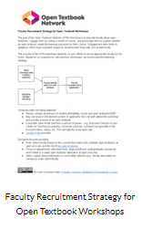
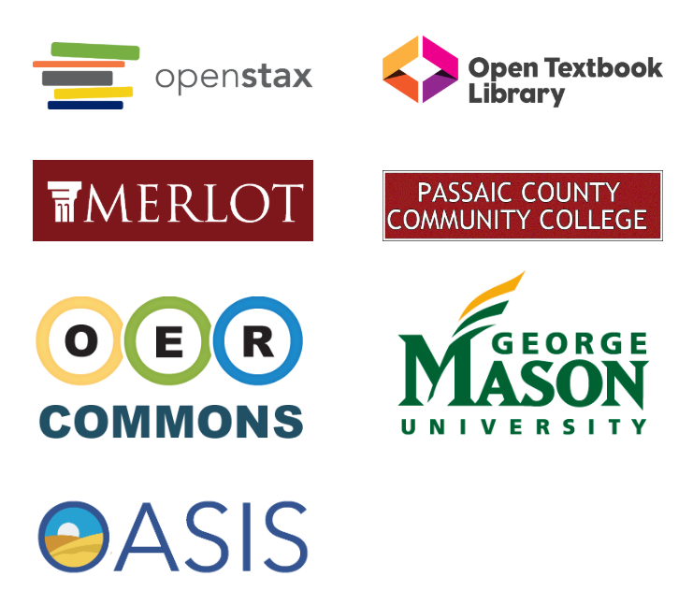
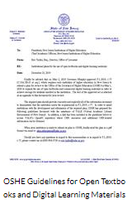
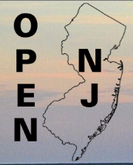
What is it, really?

Slide 6
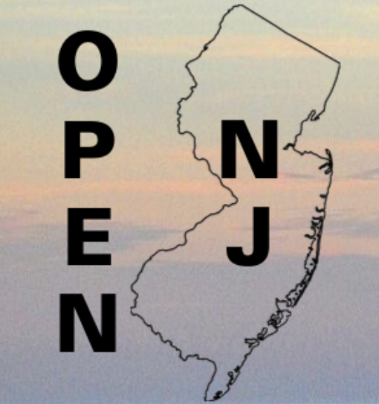
An Example
OpenStax textbook adopted by:
Atlantic Cape Community College
Bergen Community College
Bloomfield College
Monmouth University
New Jersey City University

Slide 7
OpenNJ Elements
Main homepage
Institutional homepages
Accessibility adherence
Full text searchable content
Multiple formats for viewing and open download
Relevant or related links from the item record
Creative Commons, public domain, and other licensing options per item
Statistics and sharing options
Item record mappable to a MARC record
100+ metadata field options from multiple schema
Submission form
Personal account setup with bookshelf options

Slide 8
Part II : Purpose and Development
URL: https://OpenNJ.net/
Full name: Open-NJ Open Educational Resources (OpenNJ) repository
General description: a statewide digital repository or referatorium collection developed for New Jersey institutions of higher education so educators can find and access OER materials
Content:
Open licensed or public domain OER adopted, adapted, and created for use in NJ
Open and affordable materials adopted, adapted, and created for use in NJ/may be referred out
Full text items with links to native sources as appropriate
Development Stage: first release

Slide 9
Part II : Purpose and Development
Evidence of need
State policies exist regarding use of a platform, either through state development or collaboration with other states (e.g. (Louisiana, Michigan, Texas, #GoOpen states at the K12 level)
https://tech.ed.gov/open/districts/
VALE Consortium (Open Textbook Network) offers access to original work but does not accept derivatives
Independent repositories exist for some institutions (Rutgers University, Middlesex County College, Passaic County Community College through OER Commons), but may be too costly for smaller institutions

Slide 10
Part II : Purpose and Development
General history
Sponsors: Middlesex County College (MCC) and VALE, NJ
Software: SobekCM
Based on MCC Digital Collections (includes MCCOER and NJOER Toolkit collections)
Development and Implementation considerations
Reviewed: OER Commons, OpenStax, other state OER collections (e.g. OpenWashington)
Customized: Information Architecture (collection and item organization), interface design, metadata, search and download features, and submission protocols
Researched: NJ-wide higher education OER content
Open licenses

Slide 11
Part II : Purpose and Development
Benefits of implementation
Assist faculty and program implementers in identifying teaching materials that have been adopted or created in the state
Develops a statewide community of practice for educators interested in OER adoption
Enables representation of all VALE institutions if they have OER content without institutional overhead
Allows familiarity with a repository system that may be useful for other digital library collections

Slide 12
Part II : Purpose and Development
Current content
MCCDC subcollection Open Educational Resources Toolkit
Adopted textbooks from OpenStax
Known OER items solicited from faculty
Items discovered through bookstore and institution website review
Individual submissions by faculty and librarians
Future content and sustaining the Open NJ
Active review by OER repository subcommittee (initial content review board)
Establishment of an advisory review committee
Collaboration with individual institutions
Updating of harvesting relationships

Slide 13
Part II : Purpose and Development
What to submit:
Any educational resource you want to share
Open textbooks
Public domain materials
Syllabi, quizzes and other ancillaries
Study guides, test reviews, ….

Slide 14
Part III: Usability Testing
Process
Split into test groups based on color of your badge
Homepage and institutional homepage
Item record
Search functionality
The Kitchen Sink: whole website, name, submission options, other functions
Using OpenNJ testing will include:
Participants submitting demographic survey to group facilitator/note taker
Facilitators/note takers asking small groups pre-planned questions
Focus group, task based scenarios, and card sorting as usability test methods
Presenters will analyze collected data and report out later

Slide 15
Part III: Usability Testing
Add OpenNJ comments at https://OpenNJ.net/response
Test methods for user centered design
Focus group
Purpose: identify user attitudes, reactions, and desires in a moderated discussion
Group: The Kitchen Sink: whole website, name, submission options, other functions
Task based scenarios
Purpose: reveal what type of content and functionality are desired, and assess ease of use of site based on user behavior when completing tasks
Group: search functionality and institutional homepage
Card sorting
Purpose: evaluate the information architecture, ensure organization of site makes sense, and discover preferences for placement, labels, and general navigation
Groups: homepage, item record
For more information, please see Usability.gov

Slide 16
Part IV: Next Steps and Discussion
Our work isn’t done!
Collect comments including recommendations, problem areas, etc.
Add comments to https://OpenNJ.net/response or email us
Put recommendations into practice
modify interface development by lead OER implementers
create help resources
Review new content to add to the OpenNJ (advisory review committee)
Develop harvesting relationships
Create promotional materials and outreach processes
Recruit other committee members to help identify content
Sustain and grow!

Slide 17
Questions? Comments?
General project development and volunteering questions
Marilyn N. Ochoa, mochoa@middlesexcc.edu, lead project manager and developer
Technical questions
Mark V. Sullivan, mark.v.sullivan@sobekdigital.com, programmer and collection and interface designer
Add comments at https://OpenNJ.net/response
Thank you!

